Slide 1
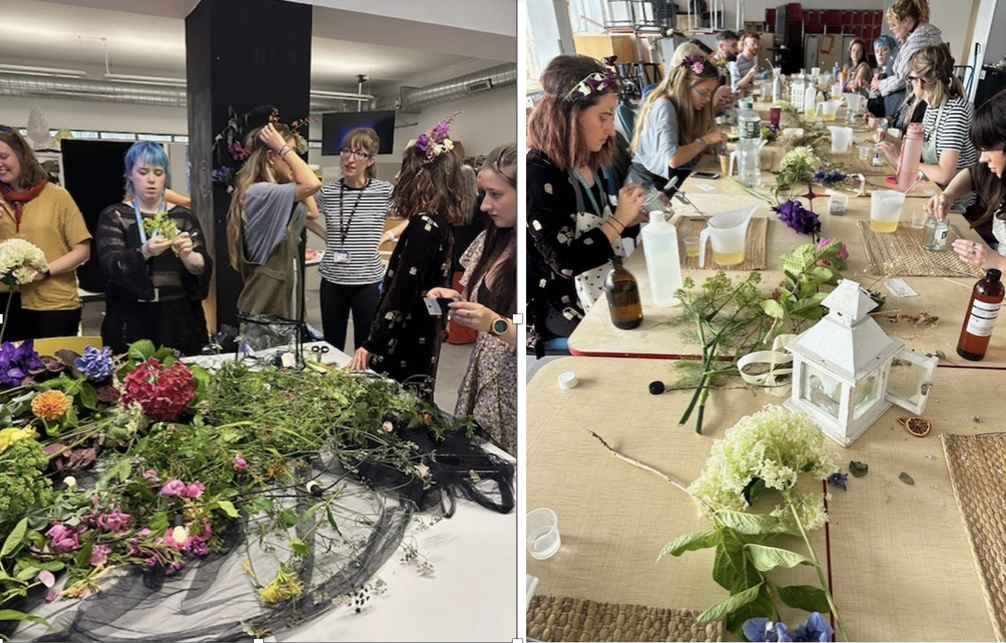
An ecology of care can be a design for rejuvenation and transforming environments for health promotion. It is a collection of actions that personalises an impersonal space.
The designing of inclusive spaces in higher education incorporates key elements: flexibility, zoning, activity spaces (for movement and interaction), materiality for the senses, proximity to nature, and spaces for interaction connectivity and comfort.
Classrooms and public spaces in civic society are not neutral.
Belonging is generative and not fixed, it is always in the making. An ecology of care is a health landscape that encourages a constellation of relationships and actions that nurture curiosity and connectivity.
Photo: MSc Art Psychotherapy students at the Belfast School of Art, Ulster University.

Slide 2
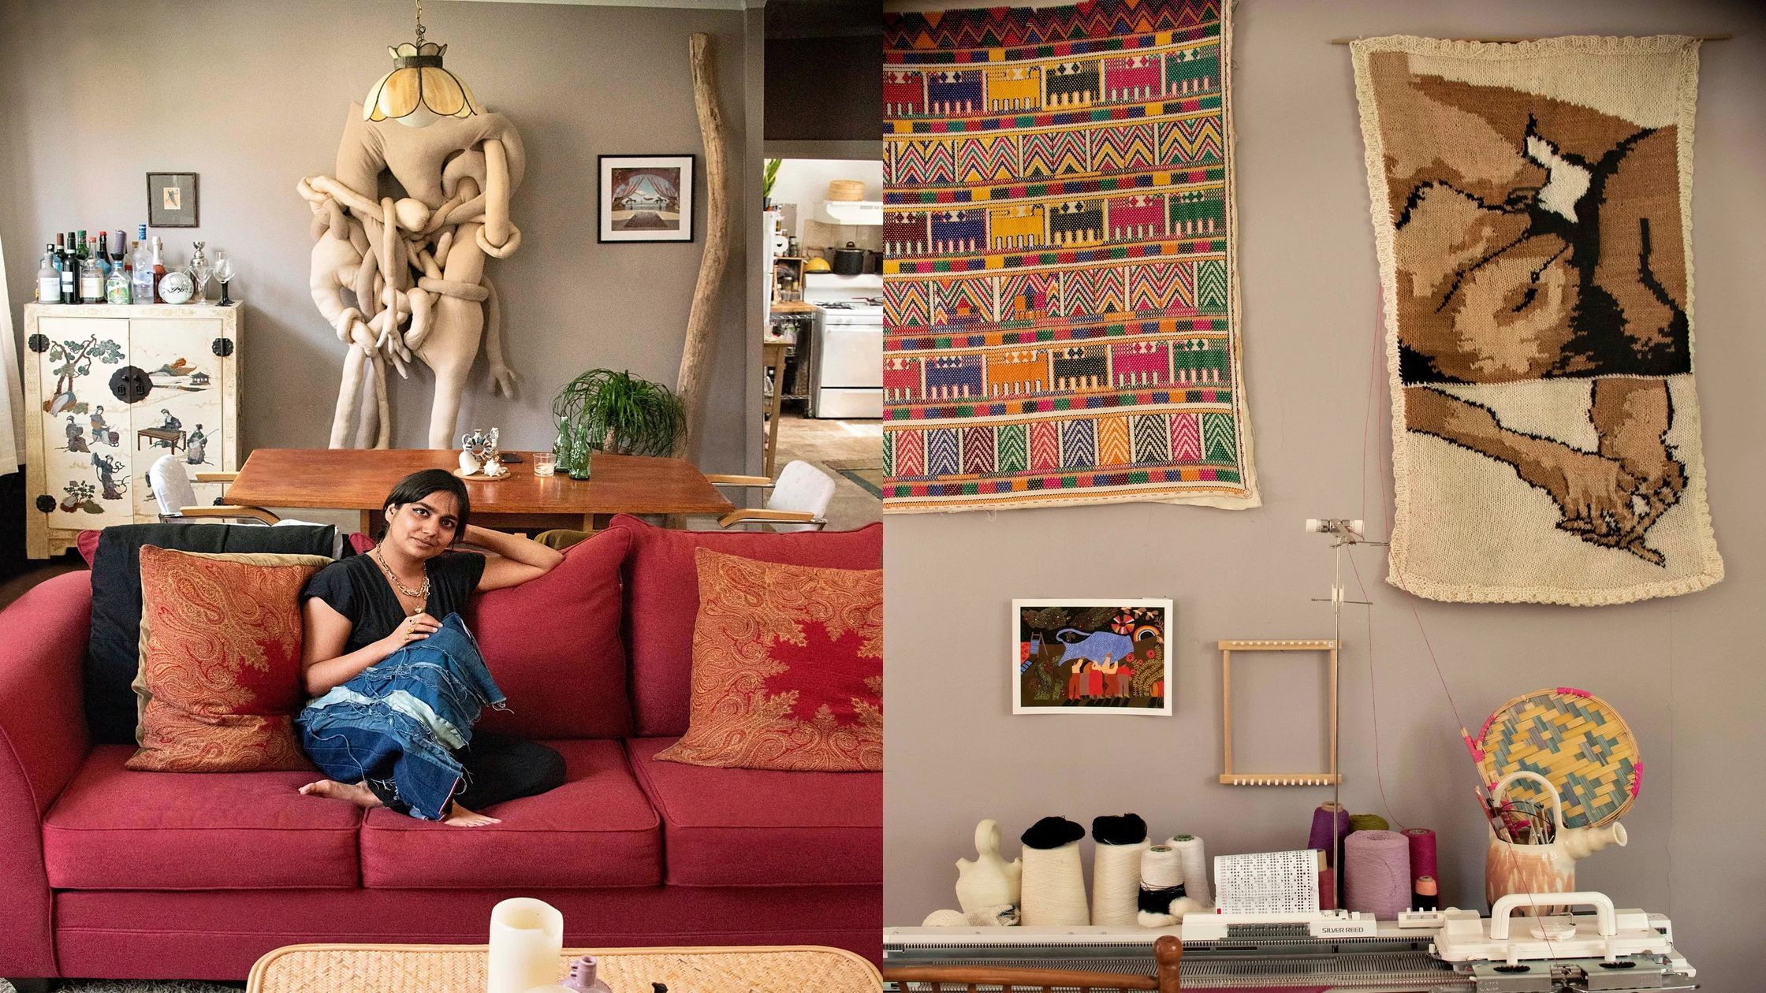
“How we spend our days is of course how we spend our lives” (Annie Dillard in Enuma Okoro, 2023).
“Often, I feel full of loose thoughts, burgeoning ideas and observations. It is a chaos of good things” (Enuma Okoro)
Objects can be used to create positive emotions and a sense of home and belonging and to reinforce everyday rhythms.
An atmosphere can be made. In the context of home, this can mean attempts to create a homelike space that generates feelings of safety and an environment that is inviting and cozy.
Objects can therefore affect atmospheres of belonging.
Home can be a gathering place, shelter and sanctuary.
Enuma Okoro, When It’s Time to Dial Down the Volume, FT Weekend, September 22, 2023
Affective Clutter: Three Viewpoints on Lived Objects by Anna Kajander and Eerika Koskinen-Koivisto, Home Culture
Shradha Kochhar’s home studio is a space for community, with friends and fellow artists gathering around the central dining table for food and conversation on most evenings. Seen on the wall is the soft sculpture, family portrait. Photo Credit: Cheryl Mukherji

Slide 3
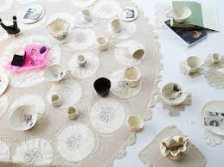
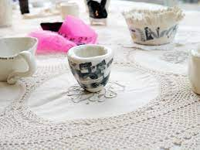
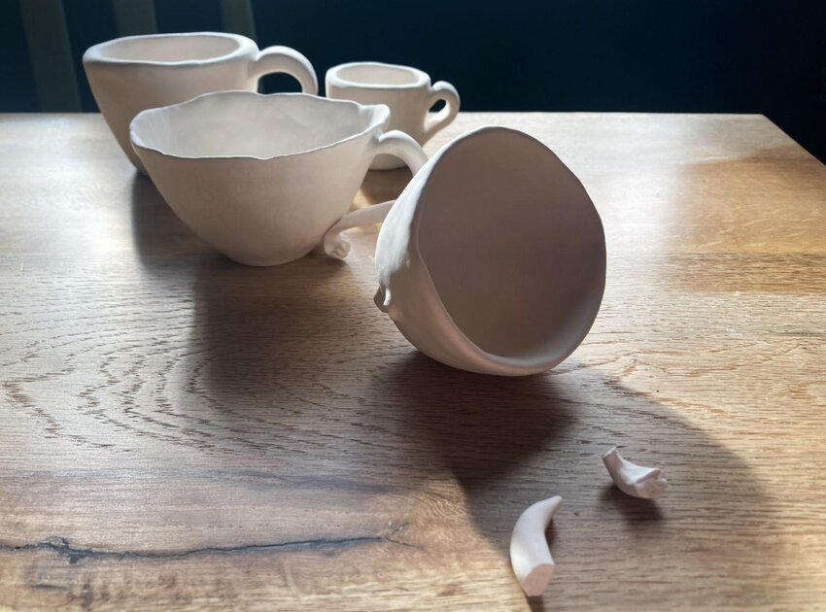
How can care be displayed as a place to gather?
Ecologies of Care are environments that act as support systems for people and places.
They are curated spaces which offer safety and inclusivity and contribute to psychological first aid.
As focus points they encourage curiosity, absorption and conversation.
They can act as art installations and open studios within classrooms, mental health services, cultural centres, parks, libraries, conferences, and festivals, etc.
An ecology of care can be a collection of found objects, natural materials, artworks, refreshments, etc. which are an invitation at a community table (Art Refuge, 2025, www.artrefuge.org.uk)
Artworks by Beverley Irving-Edwards

Slide 4
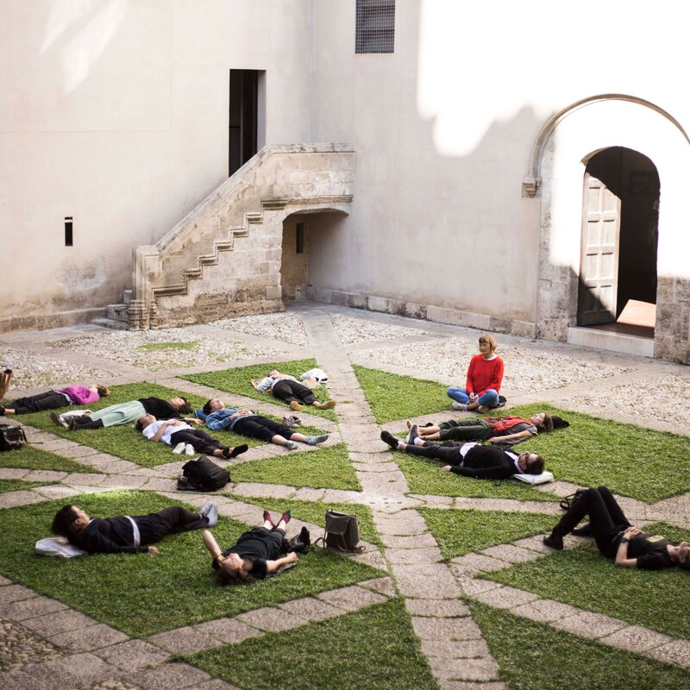
Ecologies of Care is also the name of a group of curators, artists, architects, and researchers convened by Urška Jurman and Elke Krasny in Slovenia (2021).
“Taking the meanings of curare – to care and to cure – which form the root of the word “curating,” they approach interdependencies in care and pay special attention to new modes of art and cultural practice that enable meaningful social and environmental encounters that create lasting and transformative relations.
Bringing together practices of maintenance and repair, multispecies ethics, social reproduction theory, public pedagogies, critical heritage studies, feminist infrastructural critique, and hydrofeminist engagements as well as the rights of humans and of nature, ecologies of care aspire to new public imaginaries of care.”
www.ecologiesofcare.org
Curator, educator and architect Rosario Talevi
Is a member of Ecologies of Care interested in spatial design and practice.

Slide 5
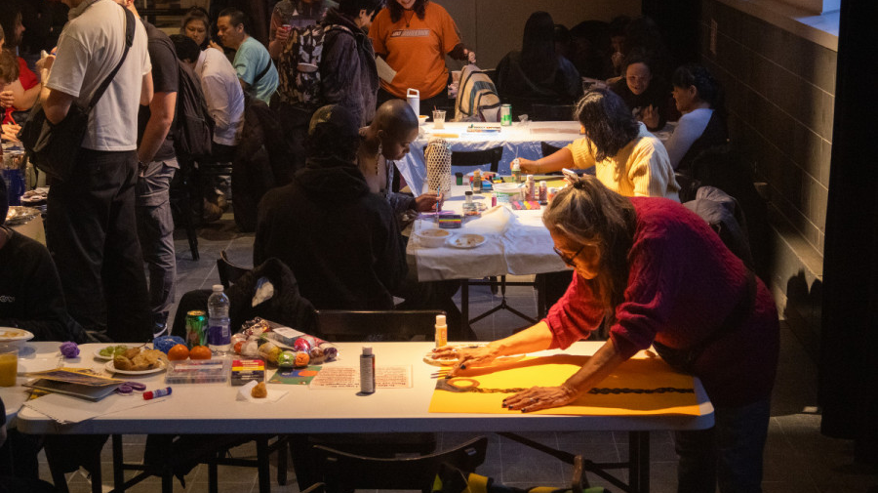
Art Hive, Community Open Studio, Montreal

Slide 6
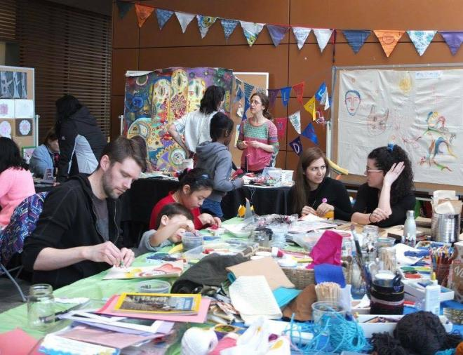
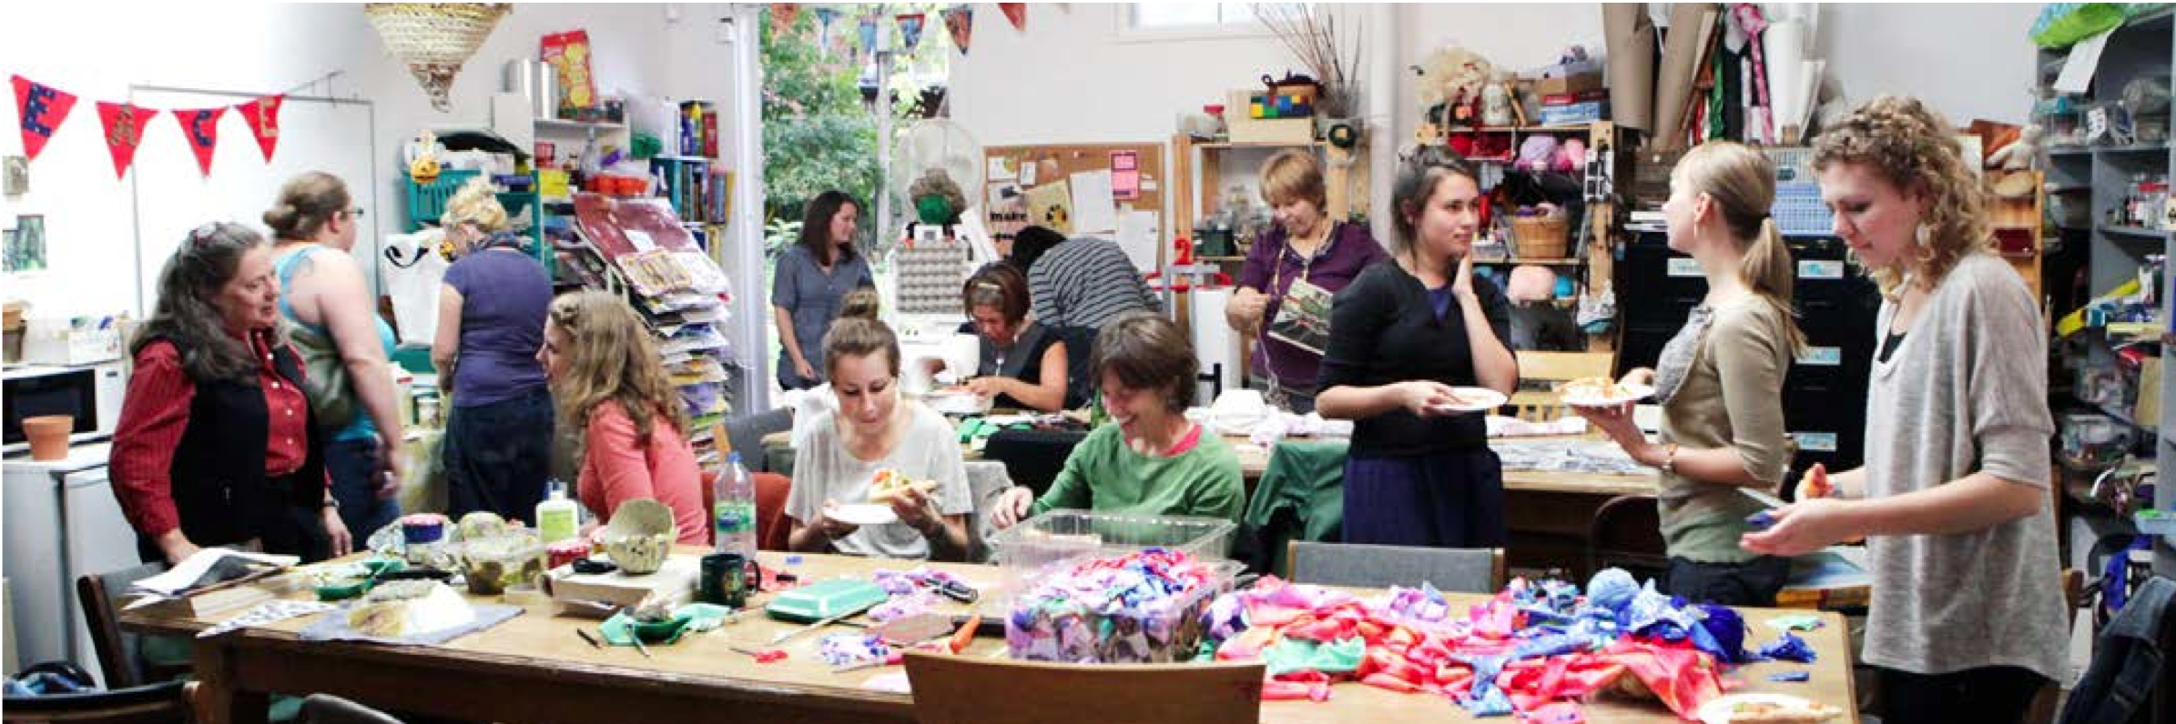
Open studios in the public homeplace promote shared access to resources and promotes equity between everyone who has a place at the table.
This is a place for creative hospitality, where each guest is a collaborator in an art activation that gives them a place at a shared table.
A place of contemplation where everything is laid on the table, and we collect ourselves. This is the curation of possessions in the home (or the public homeplace studio) for the purpose of making special what already belongs to us both individually and collectively.
“When we speak of needing space to clear our heads, we are seeking ways of ordering the chaos within…I need quiet spaces to allow my mind to make connections and draw conclusions of its own accord.”
Enuma Okoro, When It’s Time to Dial Down the Volume, Financial Times Weekend, September 22, 2023

Slide 7
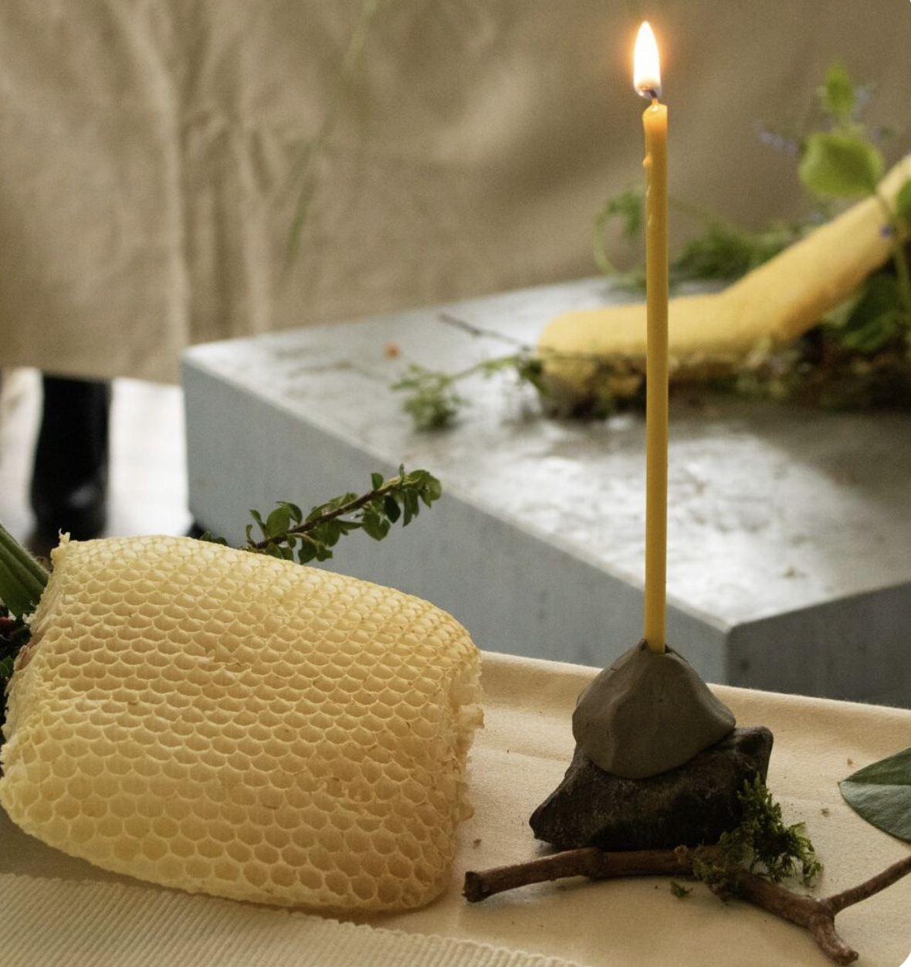
Homemaking is where we create comfort zones.
Homes should become an extension of ourselves, because they serve as foundations for our well being, identity, and memories.
Our worldly goods are also our psychological possessions and archaeology. As artefacts they bring life experiences together through either their use or meaning.
What do we live with and carry with us as mementos, decorations, ornaments and trinkets that are part of our making?
Photo: The Living Table curated by Désirée Coral, The Living Table is inspired by the life that grows around a table: from the life of insects that pollinate crops to the cultural and political life made manifest in recipes, traditions and dinner table habits.

Slide 8
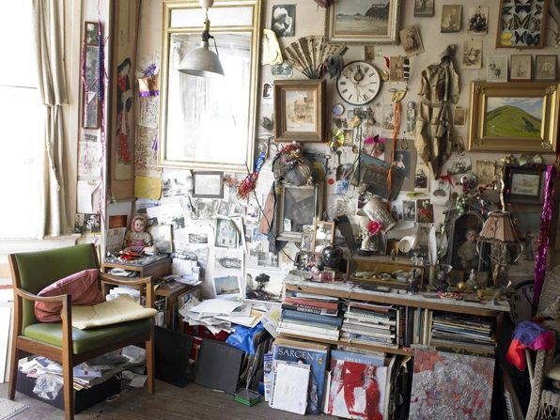
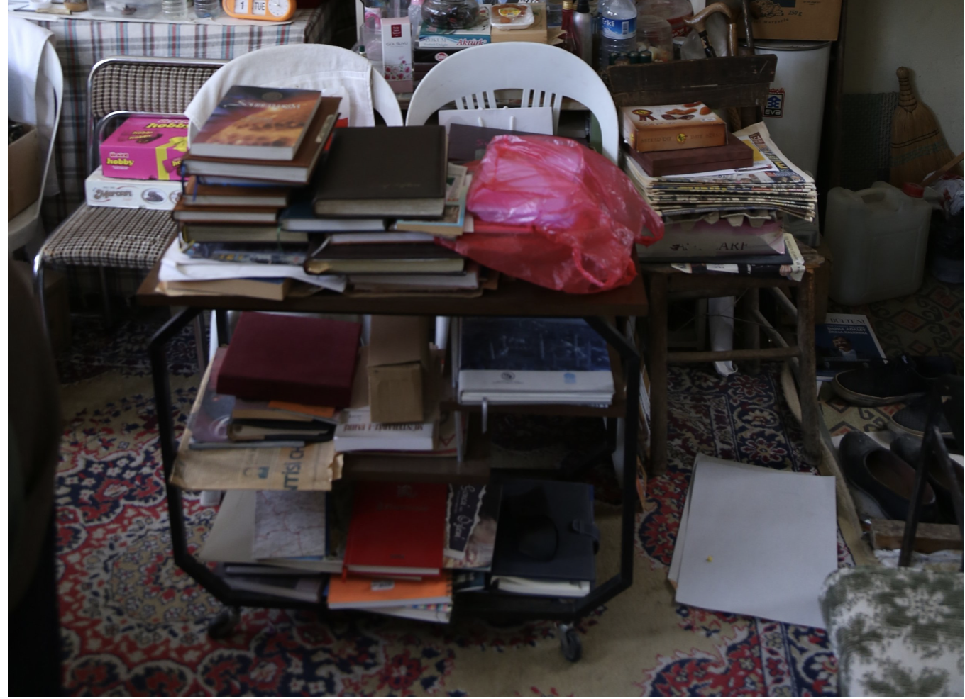
The possessions of our lives are brought together as a collection that associates to storytelling.
These possessions may be a combination of functional objects, bric-a-brac, heirlooms, trinkets, souvenirs, handmade artworks and the ephemera of possessions in general—no object is excluded in the production of home. Displaying our possessions is not unlike a form of journalling.
So different displays can reflect life landscapes, the seasons of our lives connected to times of the year and thinking about seasons in terms of different life experiences and chapters in our lives.
Even clutter can be considered an art installation, an archive of our life collections on display as an idiosyncratic arrangement which often characterises life on the move.
Bottom Photo Credits: Sahin Sezer

Slide 9
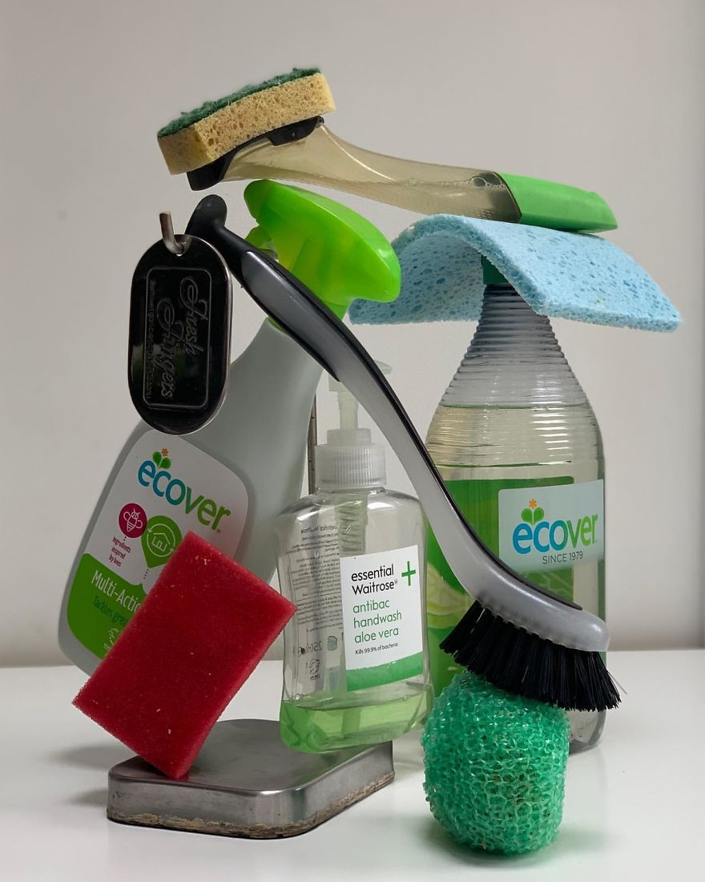
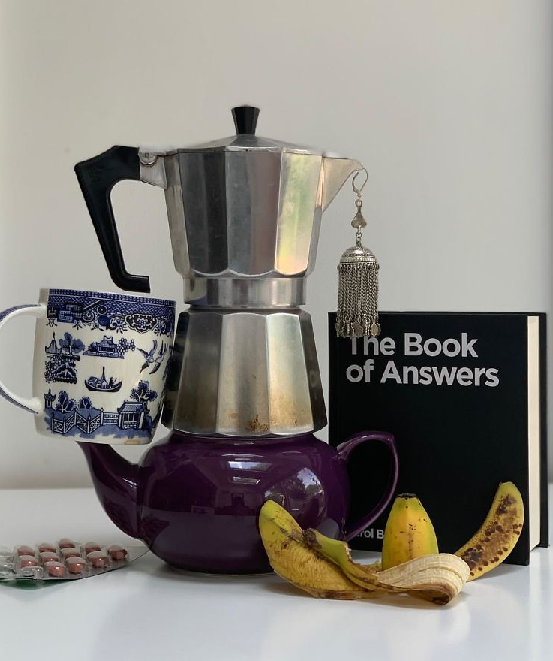
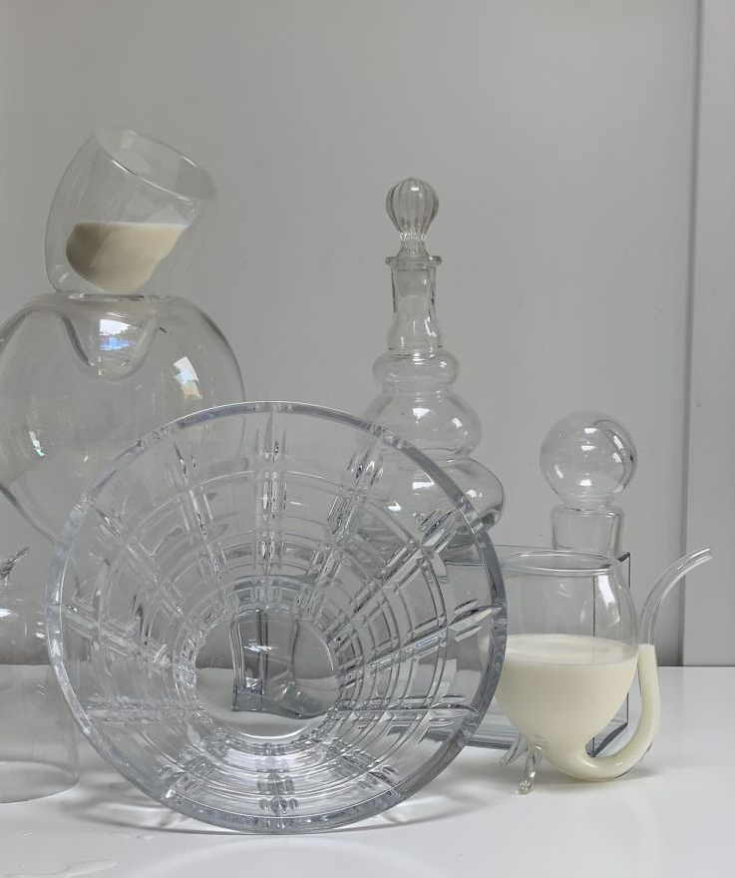
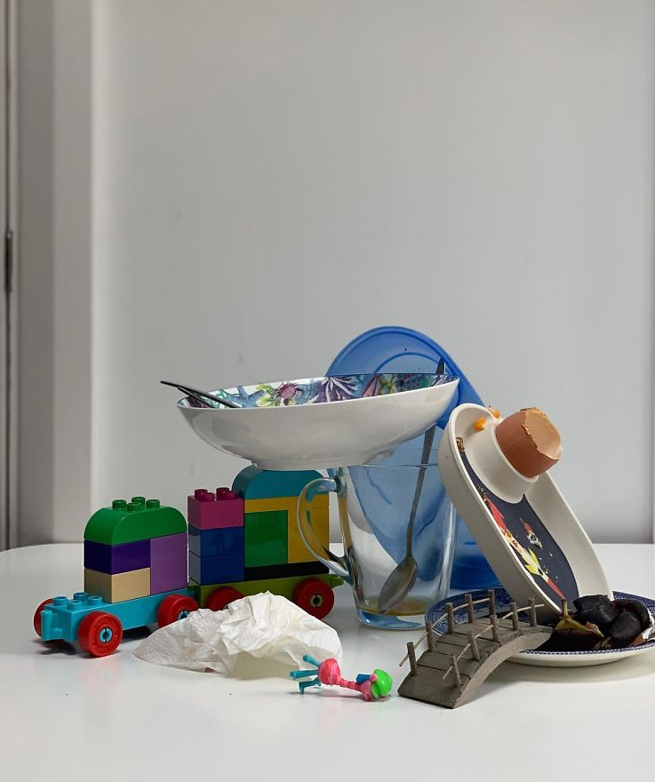
These displays are energies of life that are compositions of remembrance and potential. They are domestic ceremonials offering refuge and a retreat into the making of our own museum or gallery where we live. Home based autobiographical landscapes preserve and compose as a material vocabulary.
Whitaker, P. & McHugh, C. Making Arrangements: The Curation of Grief in the Home Studio, Canadian Journal of Art Therapy
Inshra Russell, I Made a Still Life Everyday for 30 Days During Lockdown, Instagram

Slide 10
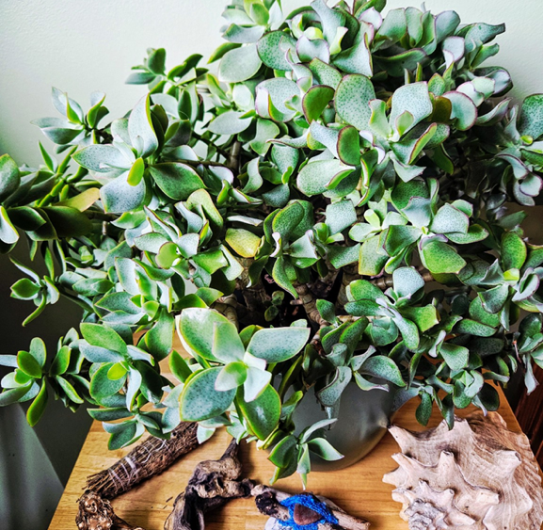
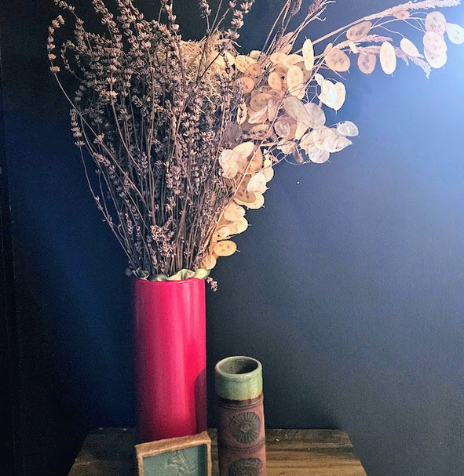
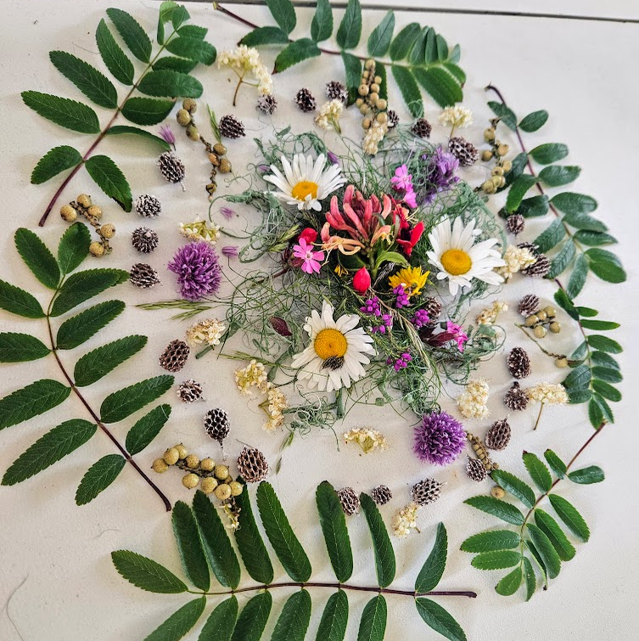

“This home décor arrangement reminds me that care can be both felt and arranged, intuitively composed, yet deeply significant. It reflects a personal ecology of care, a quiet system of interconnected elements that nourish, support, and transmit care to me. The jade plant anchors the scene, symbolising rootedness and regulation.
Around it, natural forms, handmade objects, and found materials form a small altar of presence. More than decoration, this is an invitation to attune, to slow down, notice, and connect with nature, memory, and self. In my art therapy practice, I’m increasingly aware of how such subtle ecologies shape the therapeutic space. The placement of materials, the presence of organic forms, and the quiet symbolism of everyday objects foster safety, containment, and relational depth. These are not aesthetic choices alone, they are intentional acts of care. Bringing this ecology into my work honours the body, the image, and the environment as co-regulators, each holding space for what may not yet be spoken” (MSc Art Psychotherapy Trainee, 2025).

Slide 11
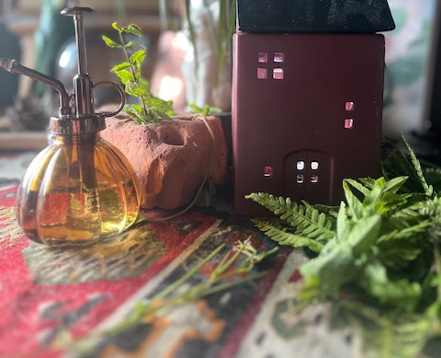
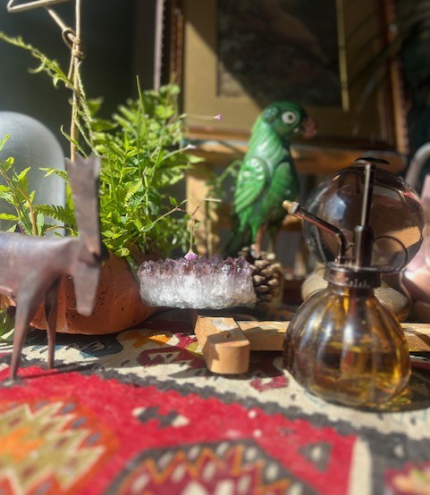
“The act of choosing an area within my home to place and curate some selected objects gave both objects and the location a new depth of meaning for me. Observing a different kind of light play upon the home collection of objects gave them new life and beauty, as they may have been on a dark shelf or in a drawer. Initially, the objects were located in different areas of my home, so when they were placed together, they became related and connected in ways I wouldn’t have noticed previously.
I felt a wonderful sense of having control over this small area of my home, where I often feel control is lacking due to living in a busy household and working long hours. This resulted in an inner feeling of peace and pride because I’d created something beautiful with little effort using objects that were mine” (MSc Art Psychotherapy Trainee, 2025).

Slide 12
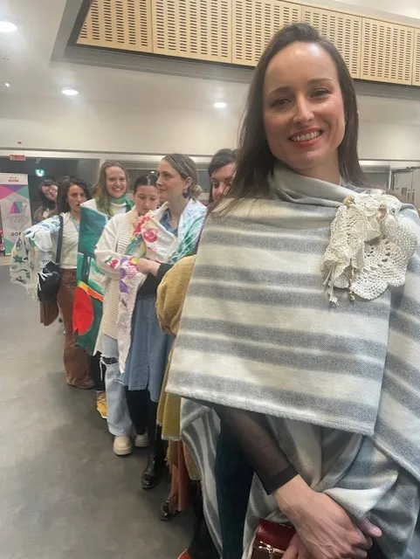
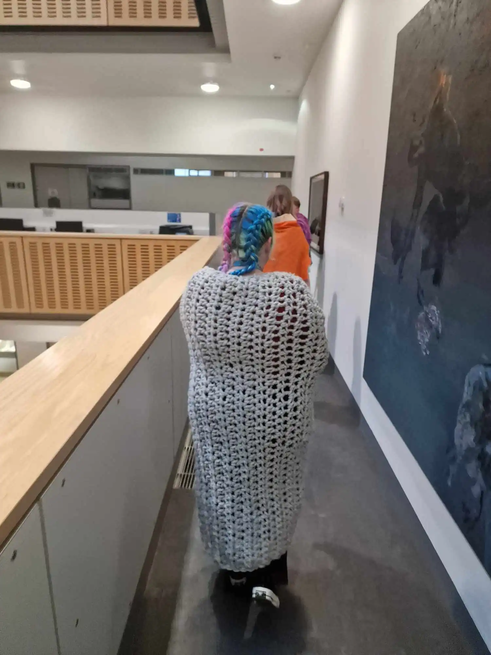

Slide 13
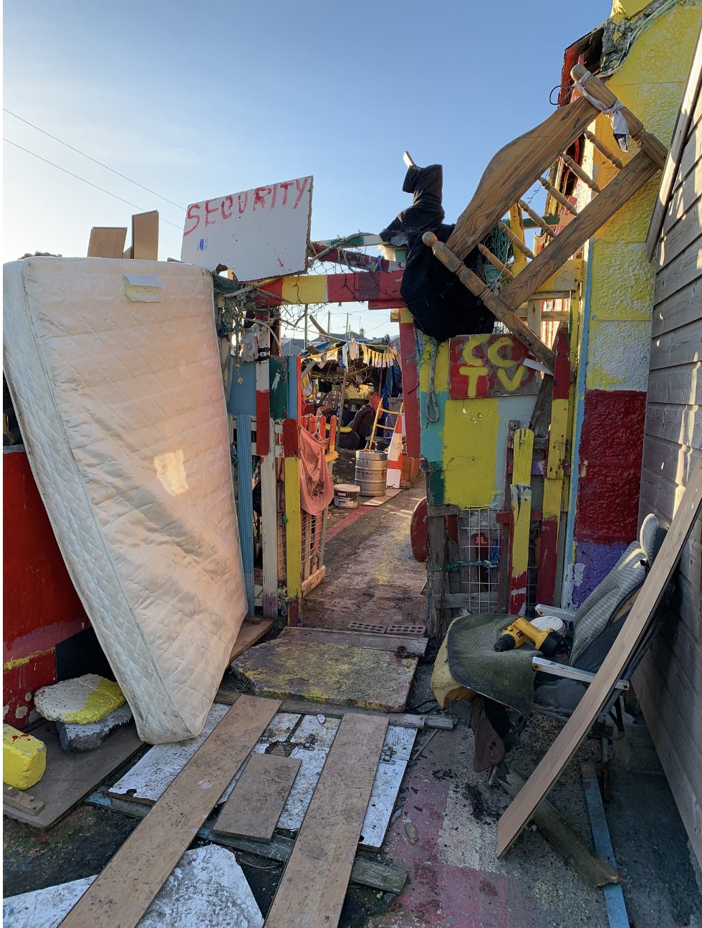
Personal objects are an archive and a story.
Our life possessions are significant as both our artefacts and as a form of personal expression.
They form display installations in the studio of the homeplace. Objects orient us and they are the milestones of narratives. They make a place for us to focus.
Our collections are all around us and we only need to find a place to bring them together.
This act of composing, also composes our minds and organises our capacity to bring organised arrangements to our lives.
Anthropologist Tim Ingold describes material thinking as a form of knowledge implicit within the physical handling and entanglement of cultural and personal artefacts. There is agency, activation and interactivity within the home studio, where each person is a curator of their life’s possessions.

Slide 14
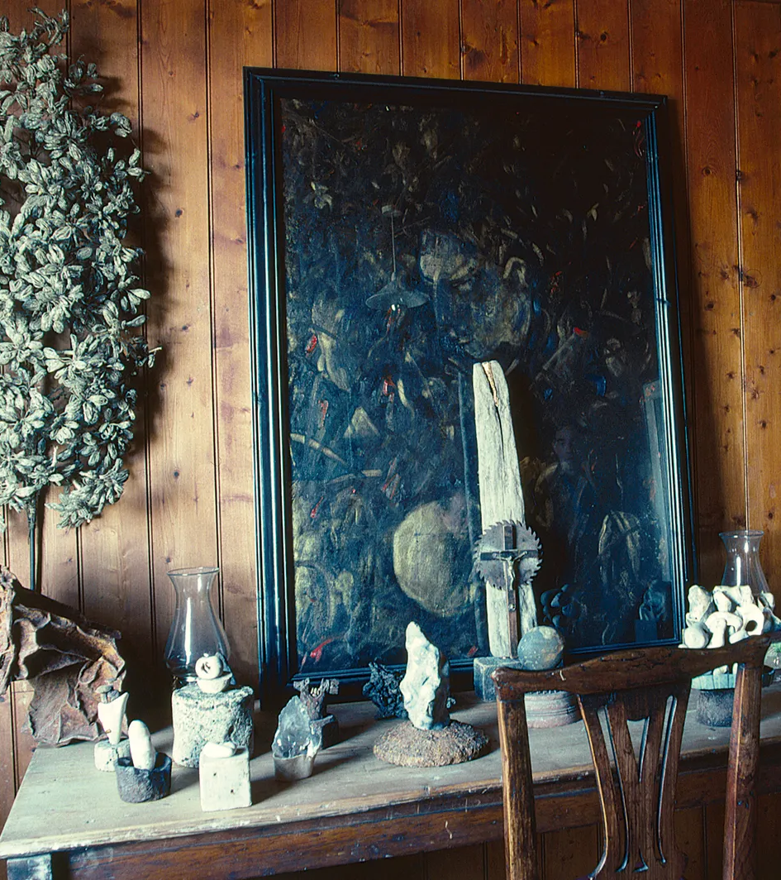
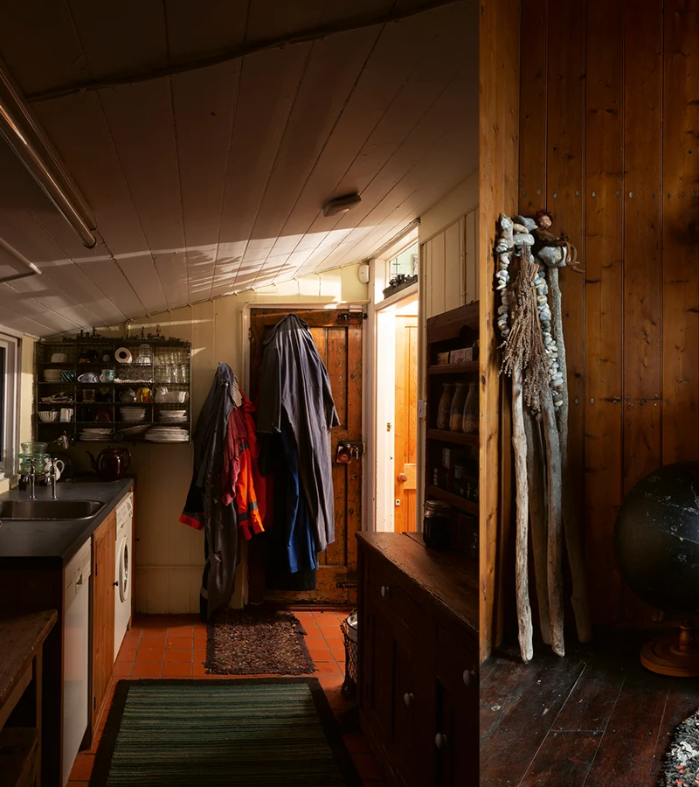
Derek Jarman’s Cottage

Slide 15
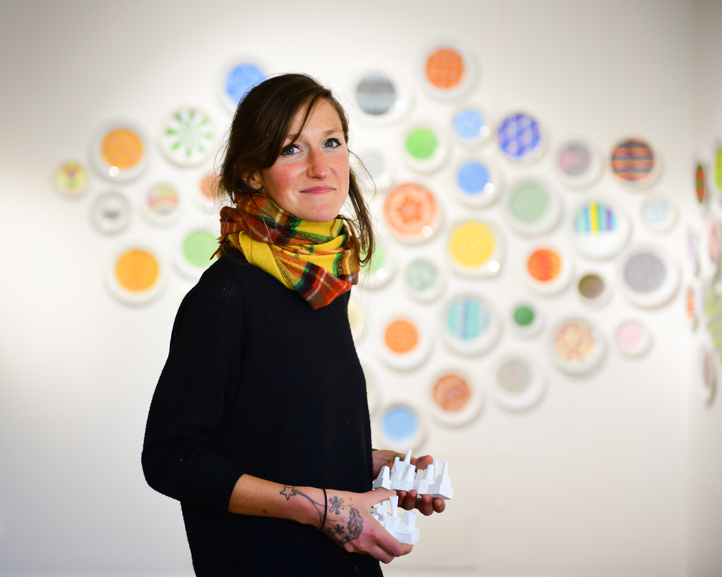
“After he died my mum took photographs of all of the things he had scratch-built around the house and garden and inside his sheds—machinery, furniture, paths, customised polytunnels and greenhouses, as well as dozens of items that were unclassifiable. They were old and new, rusted and freshly painted, broken and fixed and re-fixed—they were made from parts of things he had made previously, and sundered and remade. My mom collaged the photographs inside a large frame and gifted it to me—a strange portrait of my dead dad’s material testimonial…”a compendium which is an autobiography”. See what he made, my mom was trying to say. See the things and places in which he still lives” (p. 74, Handiwork)
"I’ll make a home in my routine. And this will be enough for me”
Handiwork by Sara Baume
A house sympathetic to my preoccupations and repetitions and observances; a house whose walls and floors and furniture diligently and persistently order themselves around my daily practices—my daily handiwork.
Sara Baume, Irish artist and writer

Slide 16
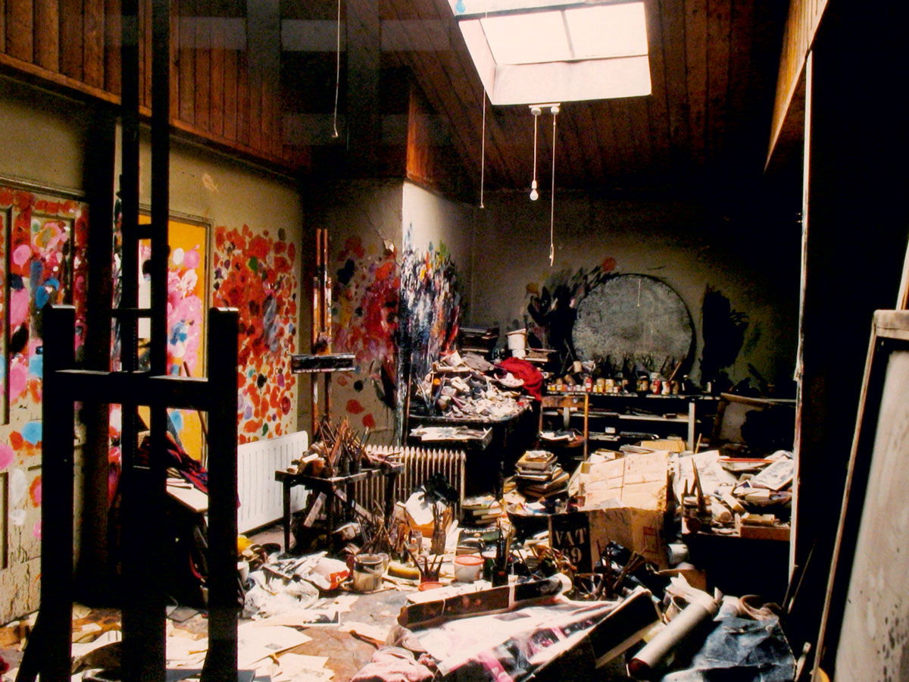
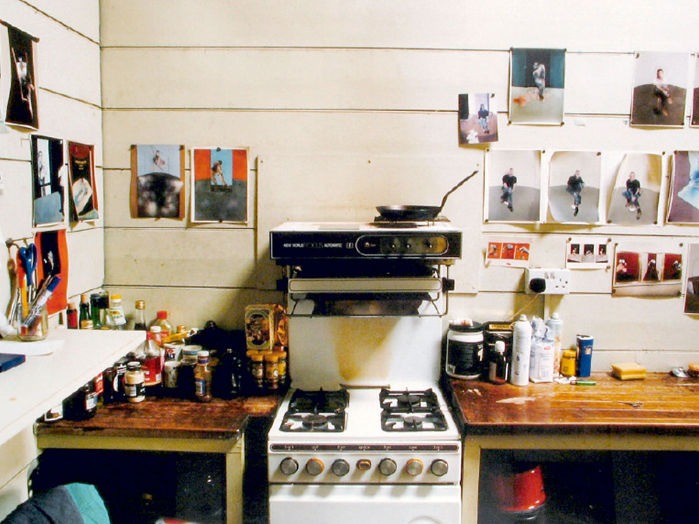
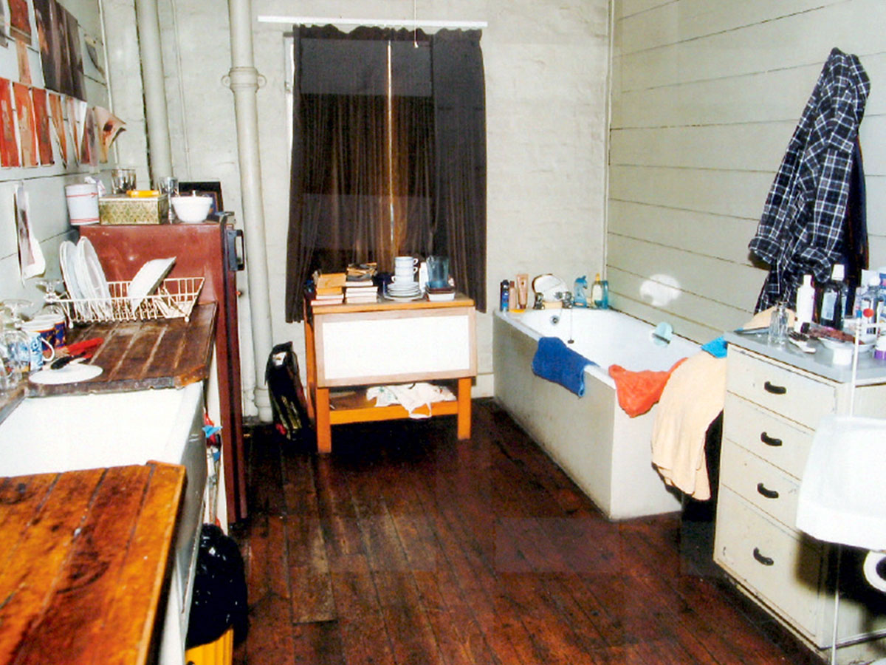
Francis Bacon, The Art of Home
This is the art of living with what we have at hand and what we make of ourselves in terms of personal possessions. Our artefacts are all around us, and we only need to place them altogether.
“I feel at home in both chaos and order, because chaos suggests images to me.” On another occasion Bacon explained, “I like to live among the memories and the damage.”
Bacon did not own cleaning equipment, but he did employ a cleaner outside of his studio environment to maintain a boundary between chaos and ordered arrangements.
Photo Credit: Perry Ogden, Francis Bacon’s kitchen and bathroom. Bacon was an interior decorator before he became an artist.

Slide 17
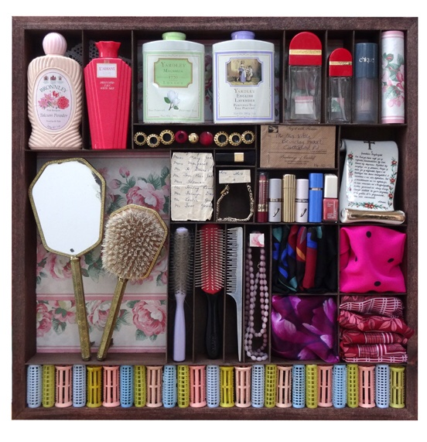
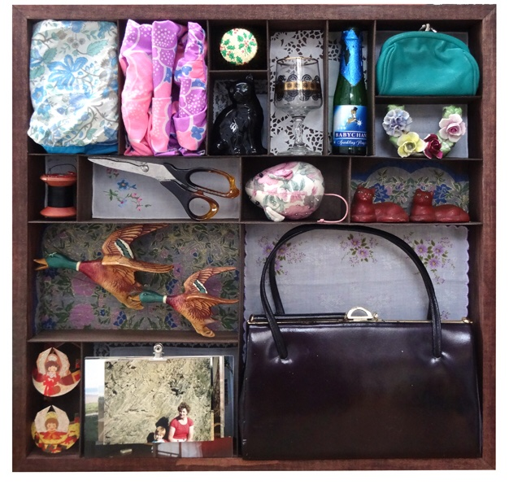
Keepsakes as way markers orient a route of commemoration at home. The objects are navigation points, and they operate as support structures. Everywhere we turn at home they are present in their arrangements of us. A display is a declaration of ourselves and our life accompanying symbols.
Katherine Jones, Memory Boxes

Slide 18
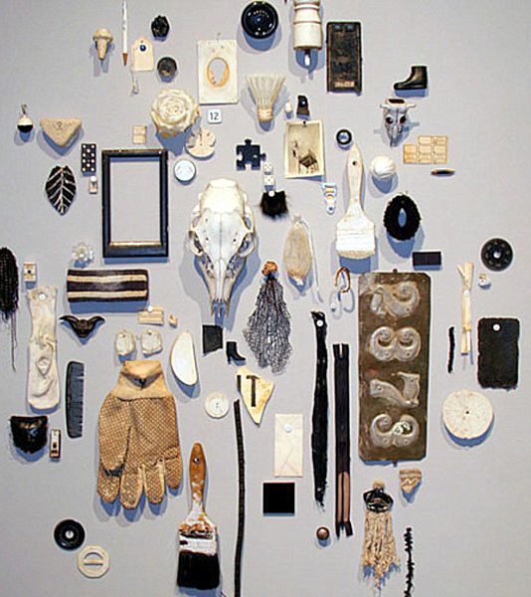
What do we make of the objects and artefacts we already live with?
Object constancy in times of loss and upheaval can be what we hold on to, and a home studio can be a place to arrange representations of our existence. Our objects are there for us as witnesses of our lives.
“Material culture mediates our relationship with loss. Personal mementos preserve memories, and they are objects in our personal museum. Mementos, memorials, words and artefacts can be understood as cultural forms that function to sustain thoughts. Domestic displays of memorabilia are readymade, close at hand, and we form a companionship with our keepsakes”
Death, Memory and Material Culture by Elizabeth Hallam and Jennifer Hockey
Photo Credit: Steve Wilman, Uncommon Objects
Steve Wilman, Uncommon Objects

Slide 19
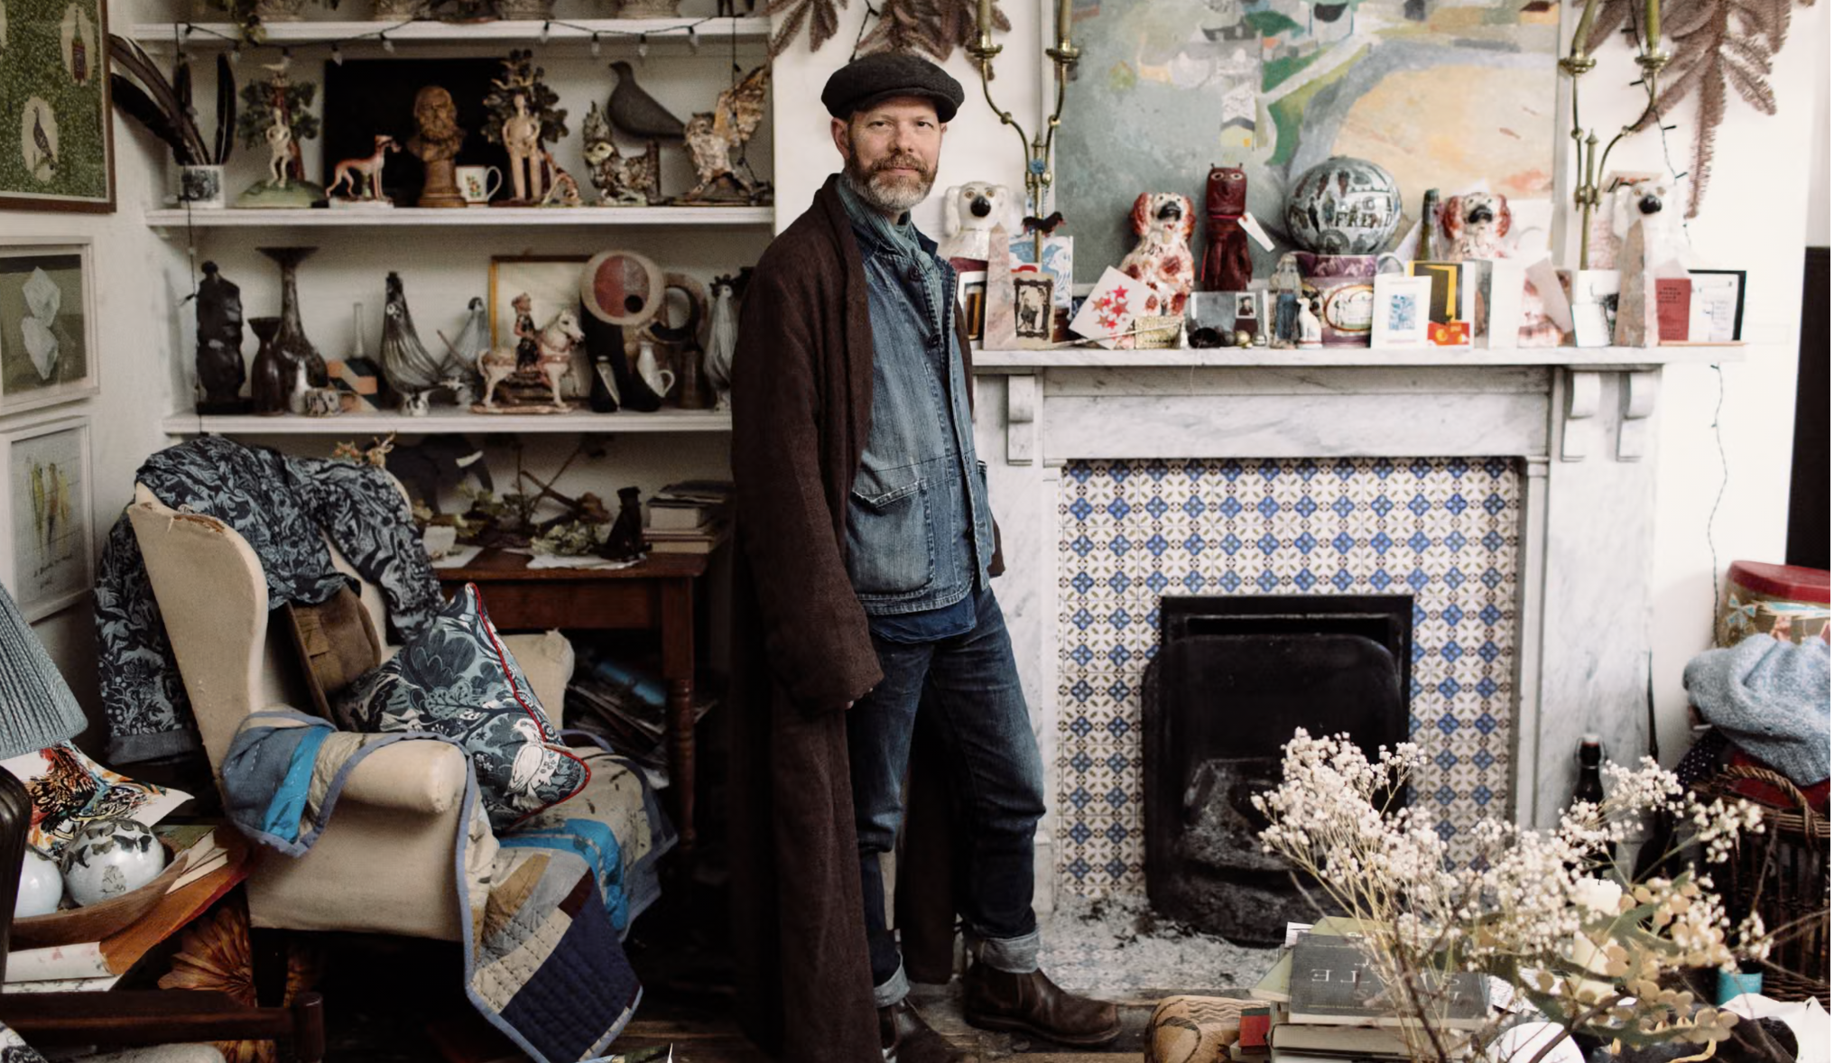
Objects tell a story and we are creatives in our own surroundings.
Making ourselves at home in our own homes.
Taking time to take stock and arrange what we have at hand in our home studio.
We can become an artist in our own residence, putting on display what inspires us as a focal point in our home.
As curators of our own atmospheres we are composing and making with what we already have at hand. We have enough art media already.
We present ourselves in front of what we have gathered. A centrepiece is what is meaningful to us—bringing everything into focus and allowing time to observe and replenish.
Mark Hearld, An artist at home and a curated life. “I like
things that are decorative and theatrical. This is not a staged
display but the formation of energy through juxtaposition”.

Slide 20
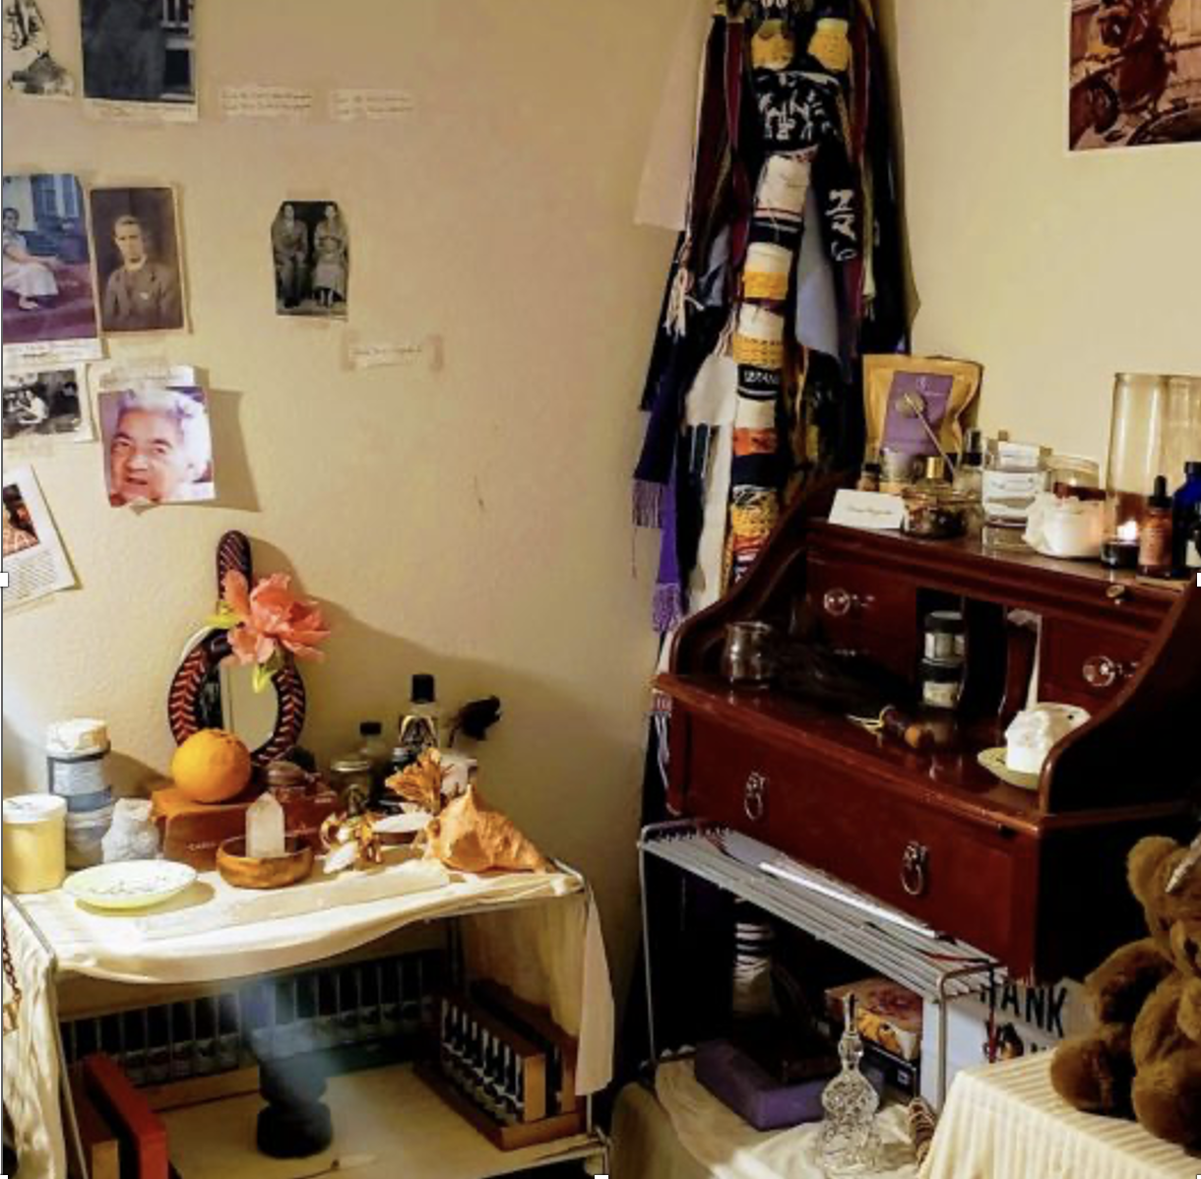
Arranging with found objects is the creation of site-specific life formations in the home studio that are portable and subject to rearrangement.
They are not static arrangements and can be moved as we are moved to compose them as an accumulation of personal content.
These displays are homemade ceremonials and offer refuge and a retreat into the making of our own home museum and gallery.
Home based autobiographical landscapes preserve the act of bringing together. They are consolidating and compose our stories in a material vocabulary.
Photo Credit: Spirit Weavers Women’s Gathering

Slide 21
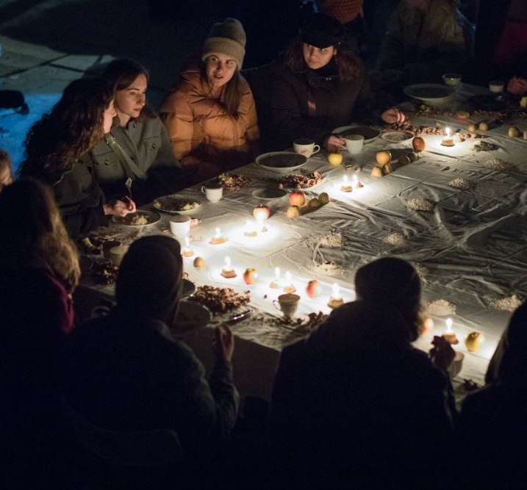
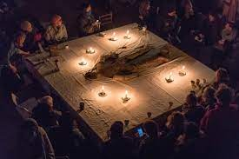
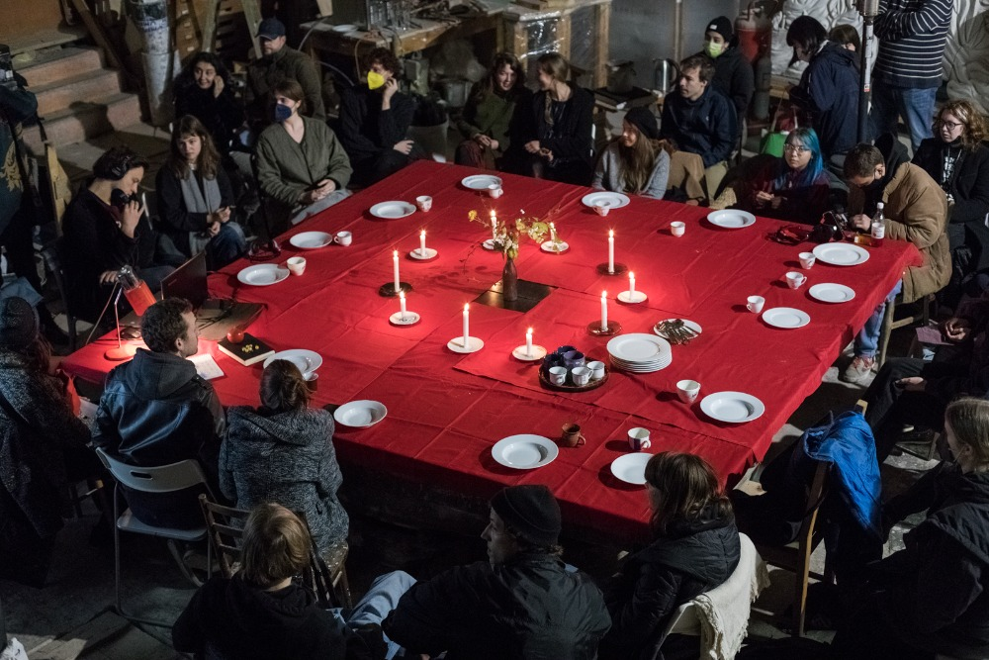
Kakfarna Artist Collective, Prague, Sculpture Studio

Slide 22
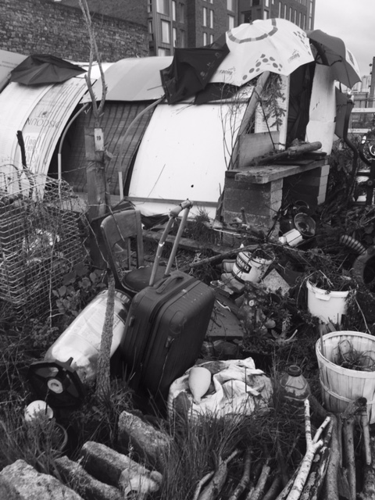
As a bricolage of materiality, this method of art making mediates disconnection through the transformative construction of what we already possess. Material culture refers to our physical surroundings, belongings, and our appropriation of objects as resources for identity both at home and in society.
Bringing together keepsakes, mementos and artefacts bestows significance. It can be an attempt to reclaim dominion over our lives in the composition of a still life (a material documentation) that depicts associations to significance, connotation, and nuance.
The effects of this form of display is an ordering that is purposeful and redemptive. The display can also depict a sense of passage, which takes centre stage in the home gallery.
Rather than a singular artwork it is a conglomerate of parts (or influences) bound together as a forging of relations. A memorialisation or commemoration, in this context, is therefore an accumulation rather than a deficit.
Making Arrangements: The Curation of Grief in the Home Studio Pamela Whitaker and Chris McHugh, Canadian Journal of Art Therapy
Bridgefoot Street Community Garden, Dublin.

