Slide 1
Connect: Learning Matters Community
Learning Matters Festival
13 January 2026

Slide 2
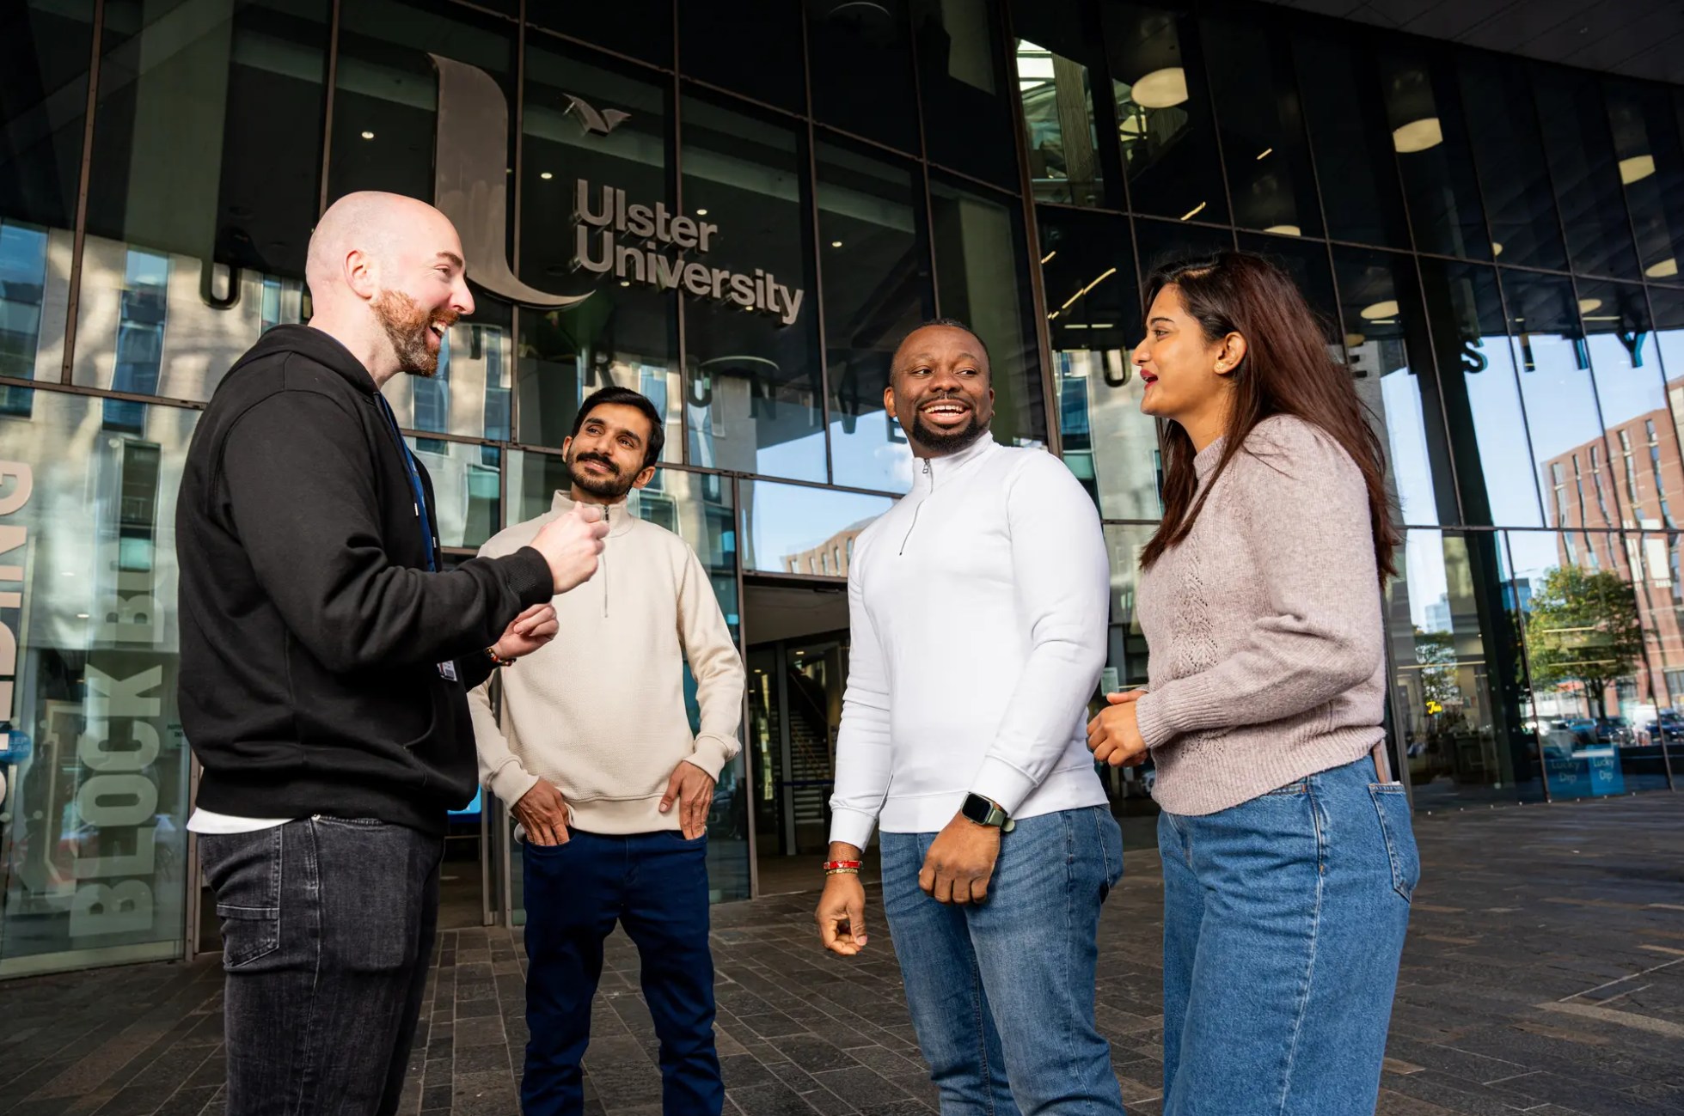
Welcome to Learning Matters Festival 2026

Slide 3
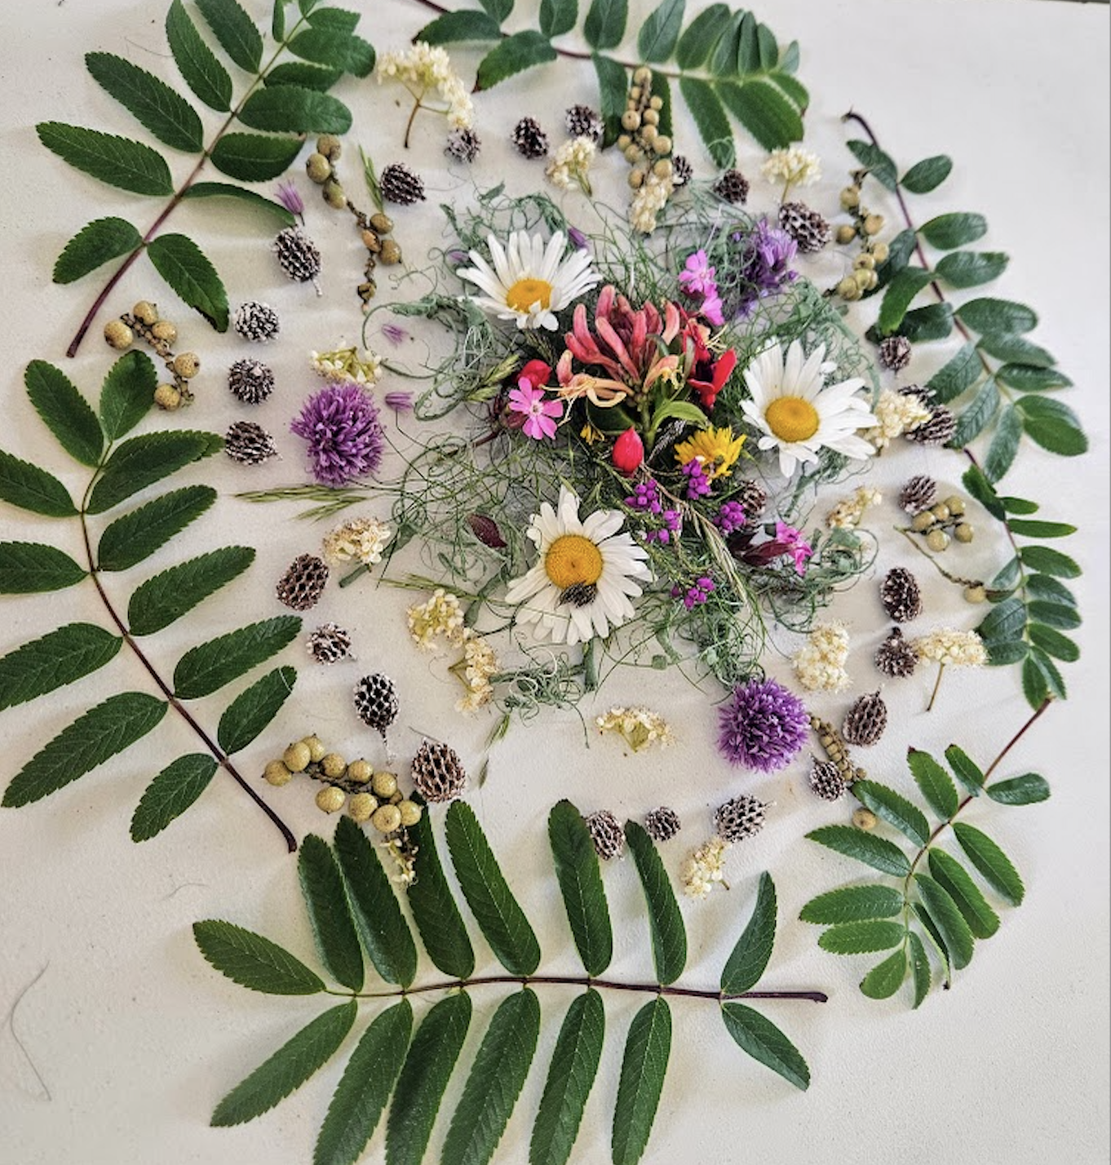
Ecologies of Care
in the Studio Classroom
Learning environments as supports for wellness, persistence and flourishing
A studio is a place for the production of potential and enterprise, the making of oneself within a space of curiosity and intention

Slide 4
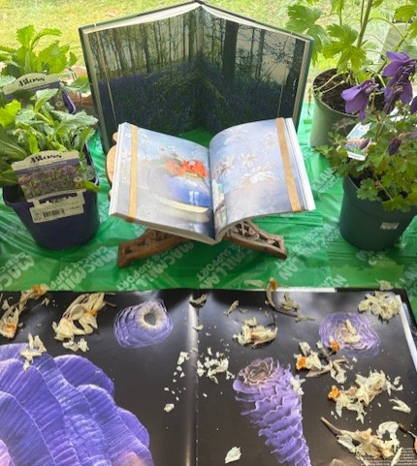
An ecology of care in higher education is an environment which bestows a comfort zone and public homeplace.
The boundary between public education and private life is no longer clearly defined, considering the prevalence of online learning (both online teaching and online learning environments).
Homework is an essential component of learning.
A university enters the homes and lives of learners, but can learners feel at home at university?
This action research identifies the potential of classroom displays, as interactive scenery, to act as nurturing environments composed of learners’ life materials, objects from home, projects, refreshments and natural materials.

Slide 5
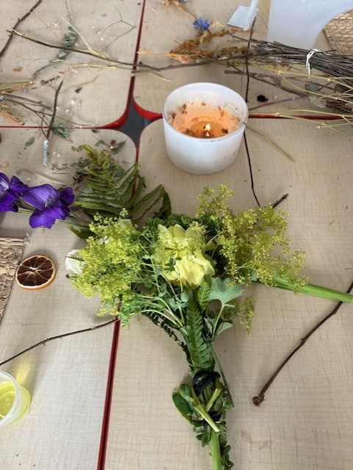
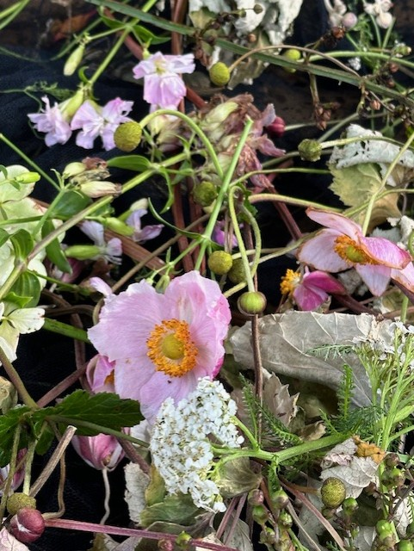
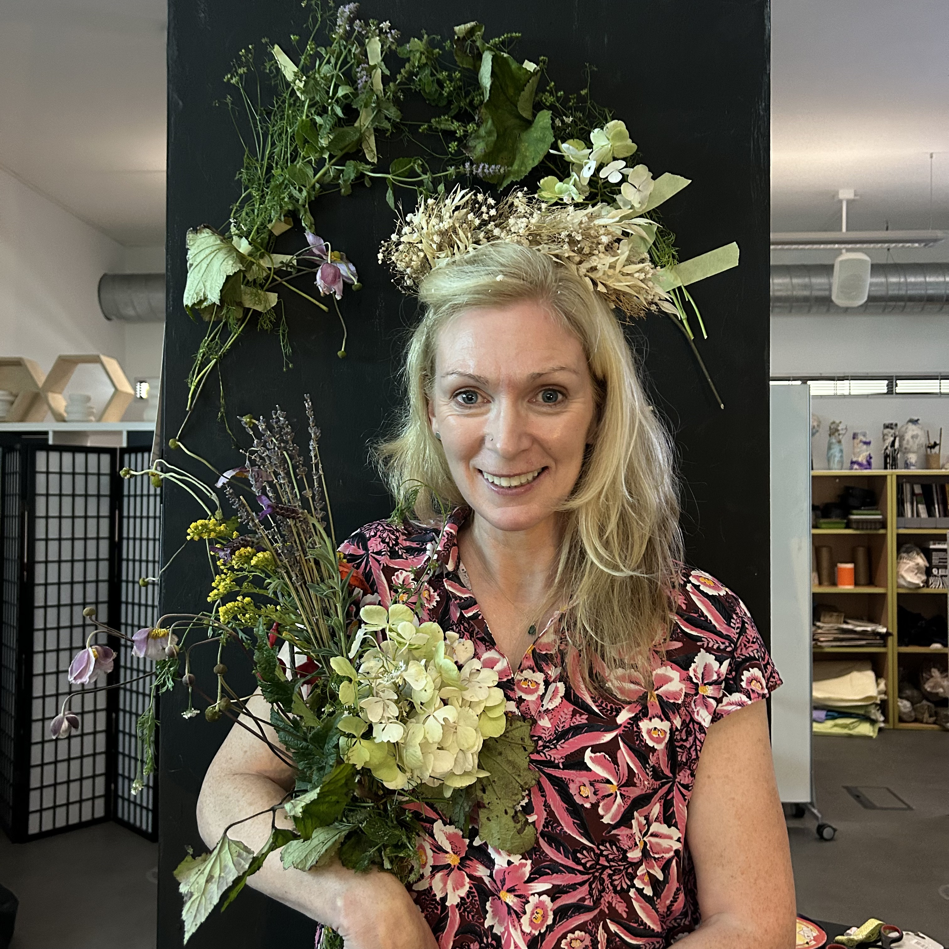

Slide 6
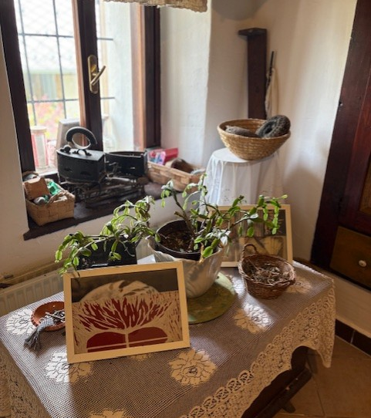
An ecology of care is a restorative space for social communication, focus and psychological composure.
Adaptable learning environments facilitate multi-sensory learning and offer the potential for recovery from psychological dysregulation
Neuroscience emphasises the significance of a well-designed (collaboratively curated) learning environment to promote learner relaxation, relatedness and conviviality.
These are attributes of not only active learning, but active brain processing recognising the significance of each learner’s identity and narrative. The ecology of care model supports belonging and mattering, two key mental health attributes for learners in higher education, within a classroom as studio.

Slide 7
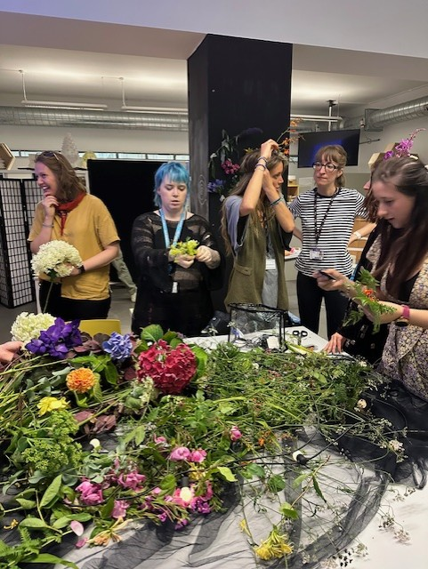
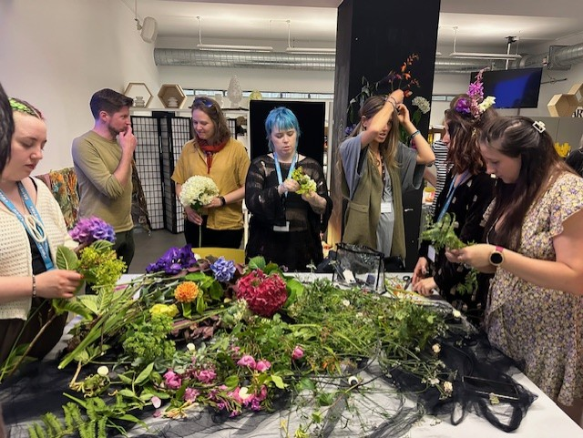
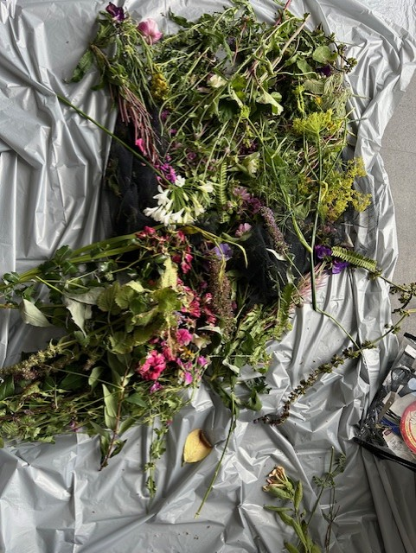

Slide 8
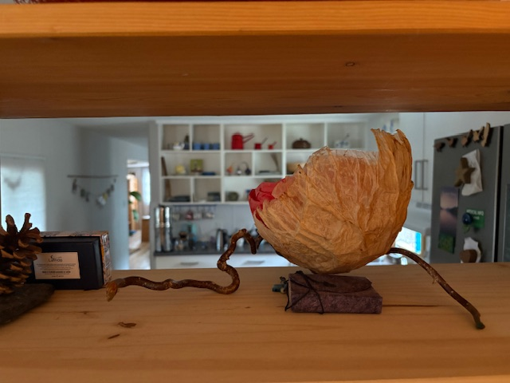
An ecology of care is a display of life materials. It is the curation of a gathering (of people, thoughts, curriculum and stories) to provide focus and a sense of occasion within a classroom environment that brings learners and educators together as a community of practice.
With a rise in student loneliness and despondency “interventions that enhance a sense of belonging, mattering and self-efficacy in students are likely to have a positive impact on persistence and retention” (Zawada, 2024, p. 2).
Zawada, C. (2024) Student drop-out and feelings of belonging and mattering in UK undergraduate allied health students. Journal of Learning Development in Higher Education, 31.

Slide 9
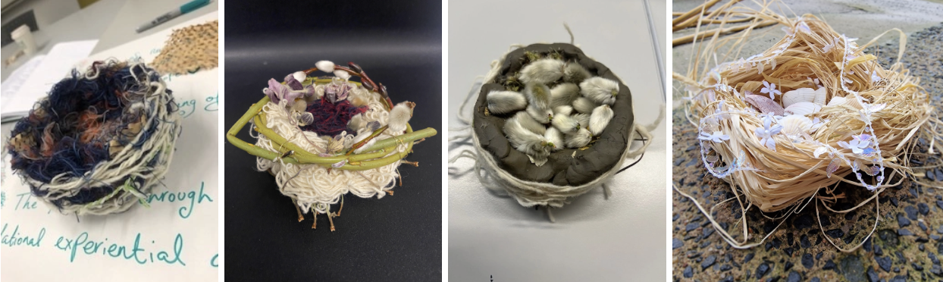
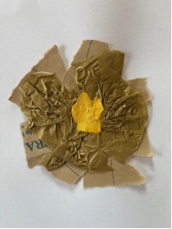
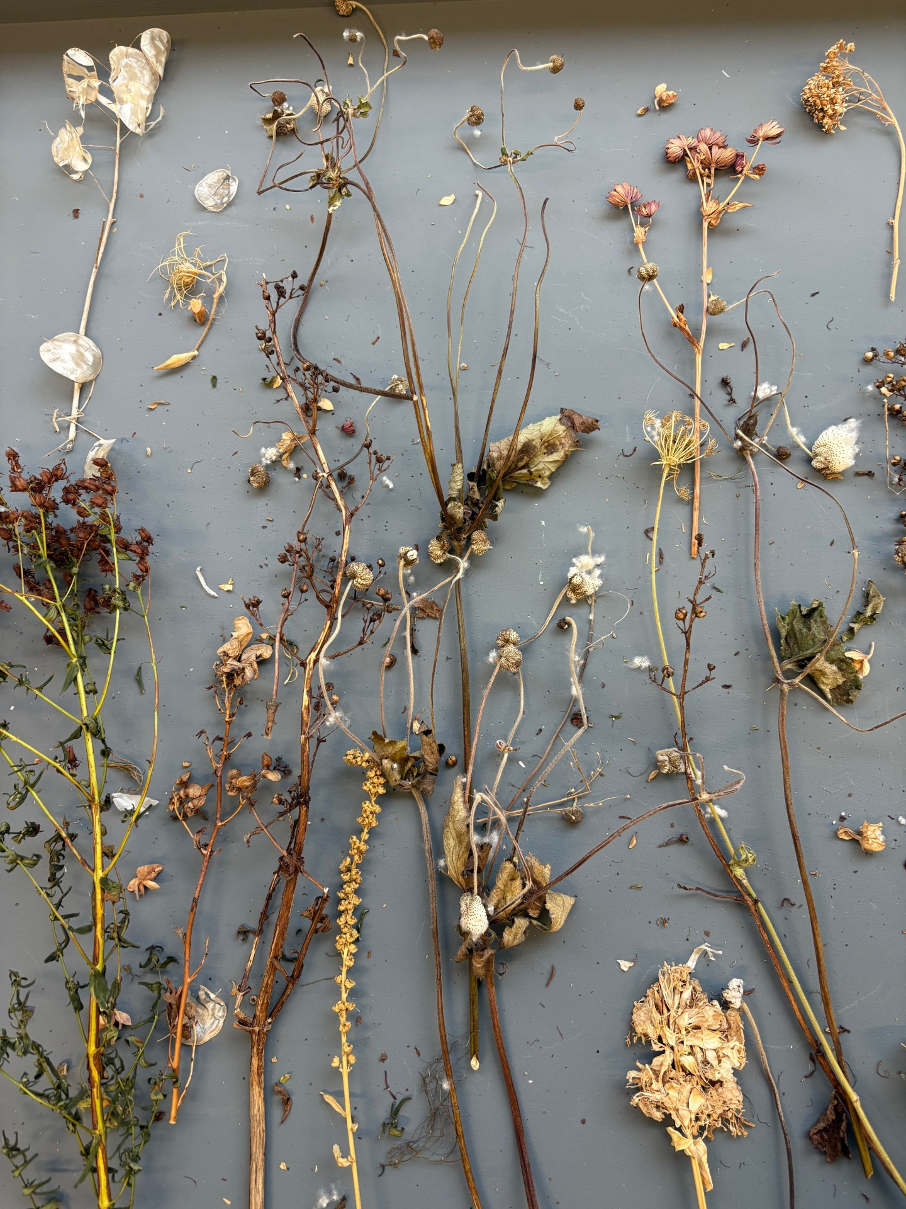
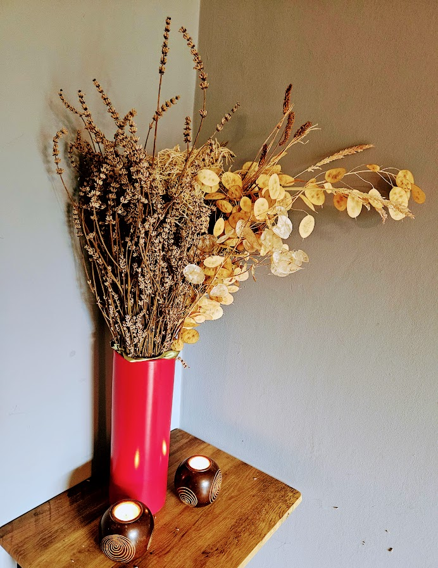
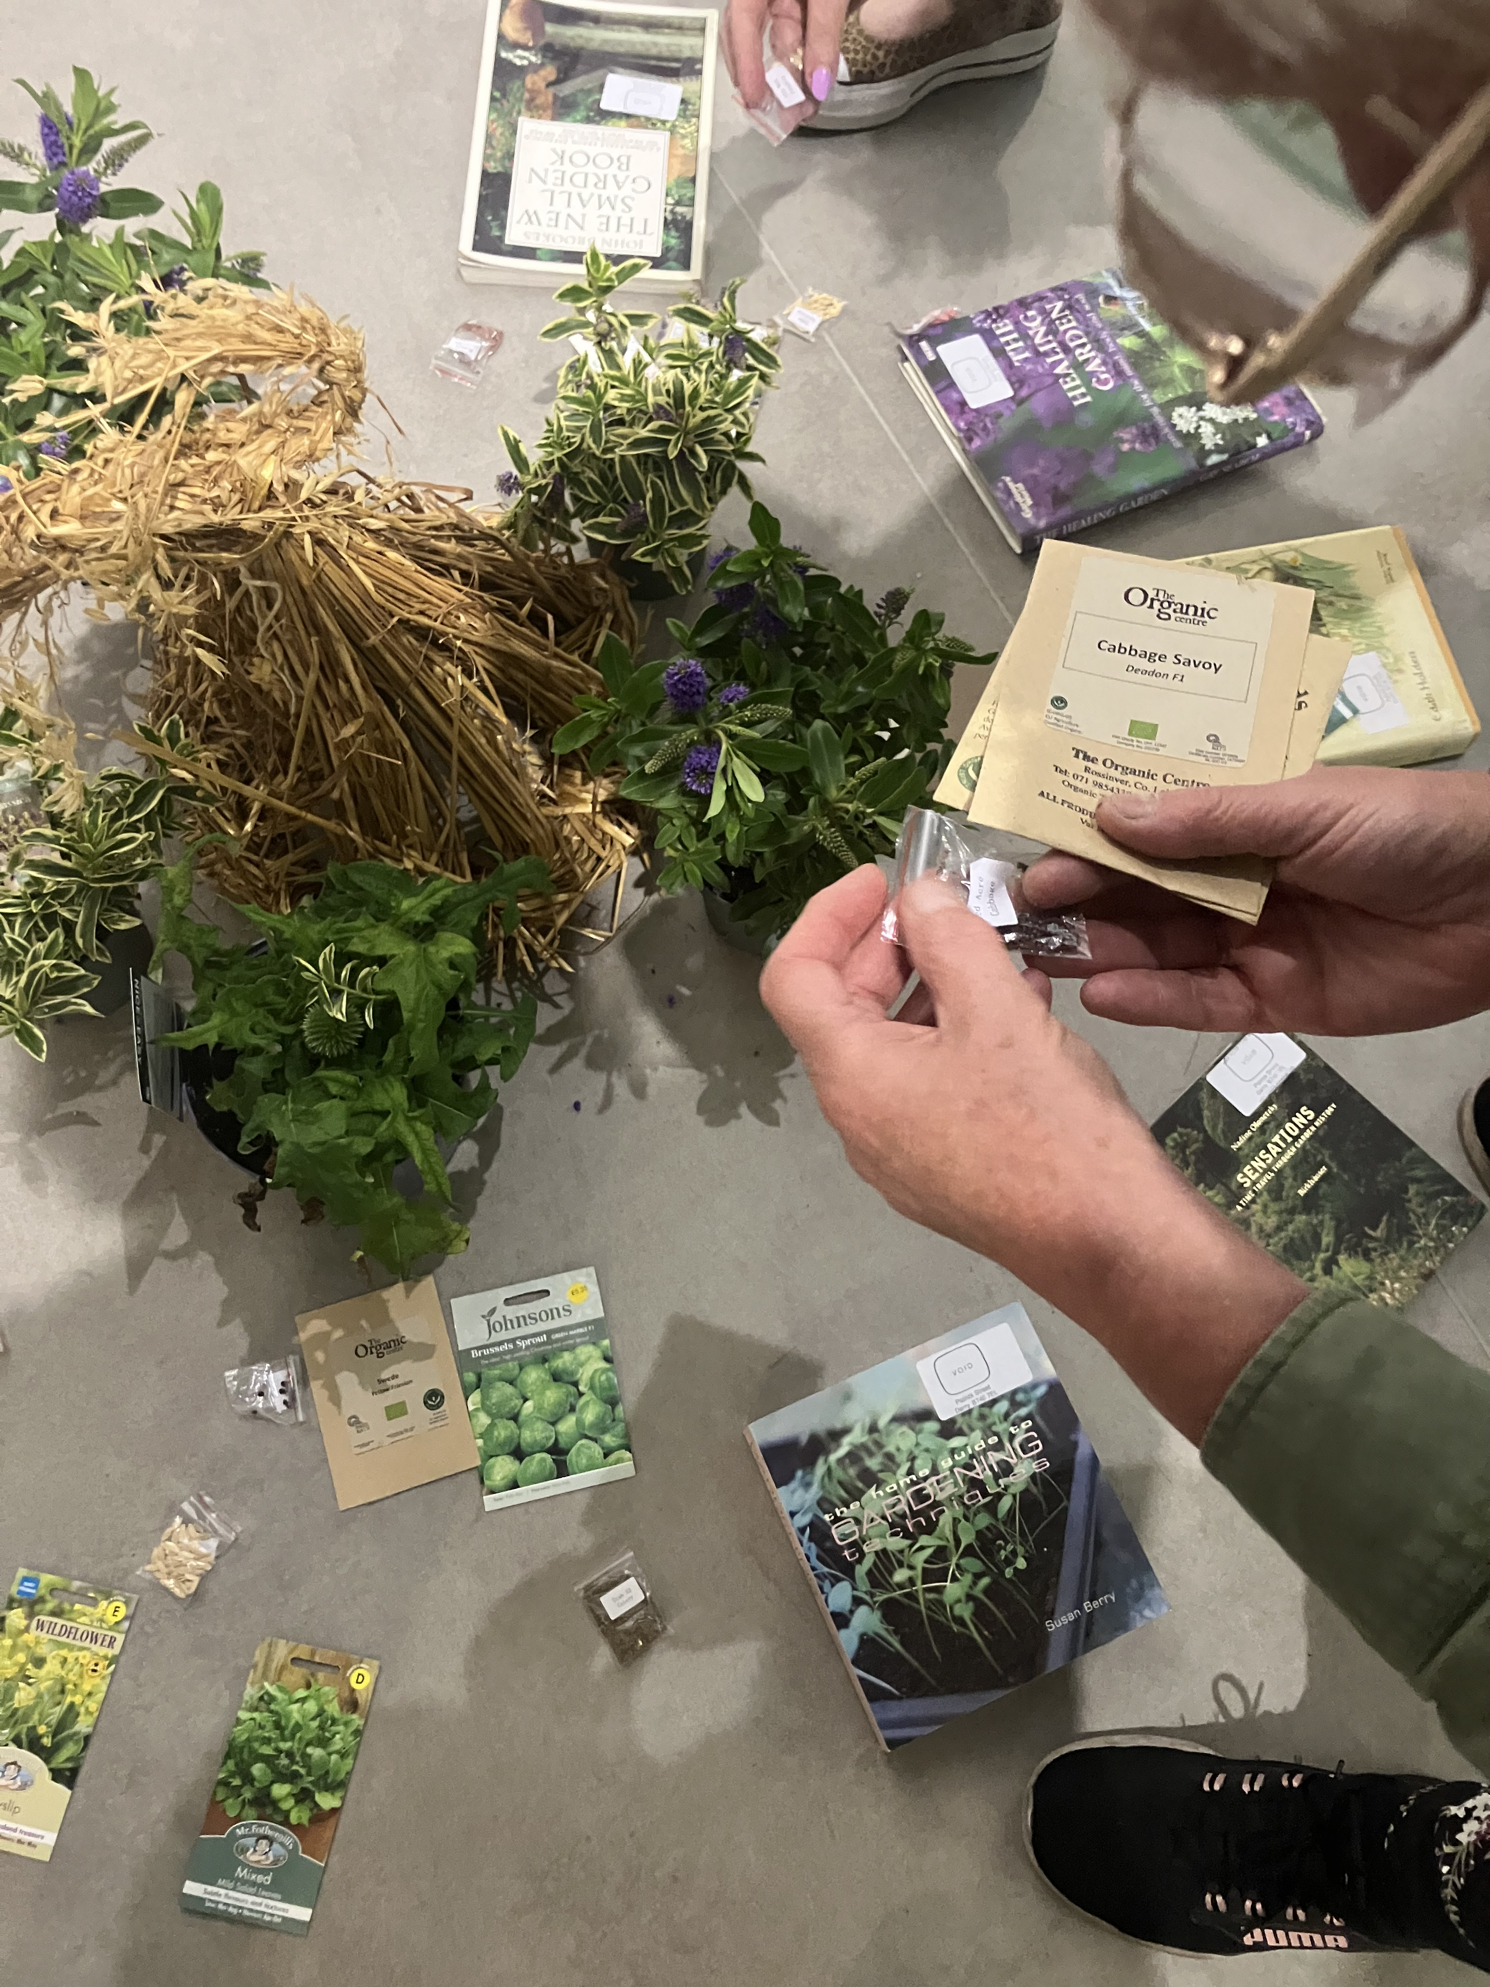

Slide 10
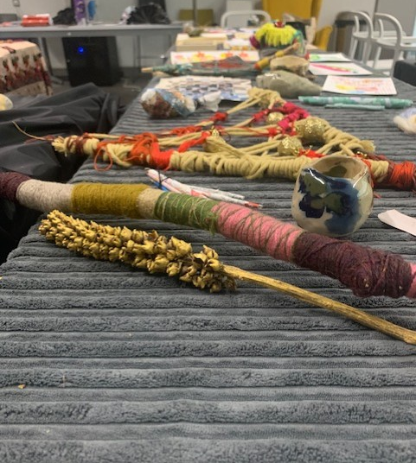
“Nesting, at home, university and work. It was welcoming.”
“I appreciated all the thought and care you have put into ecologies of care right back to the beginning of our course. It has been a sensory feast and provides a feeling of being cared for. It is very gentle and soothing.
“This was a beautiful tactile experience. A feeling of growth both during the course and the next steps.”

Slide 11
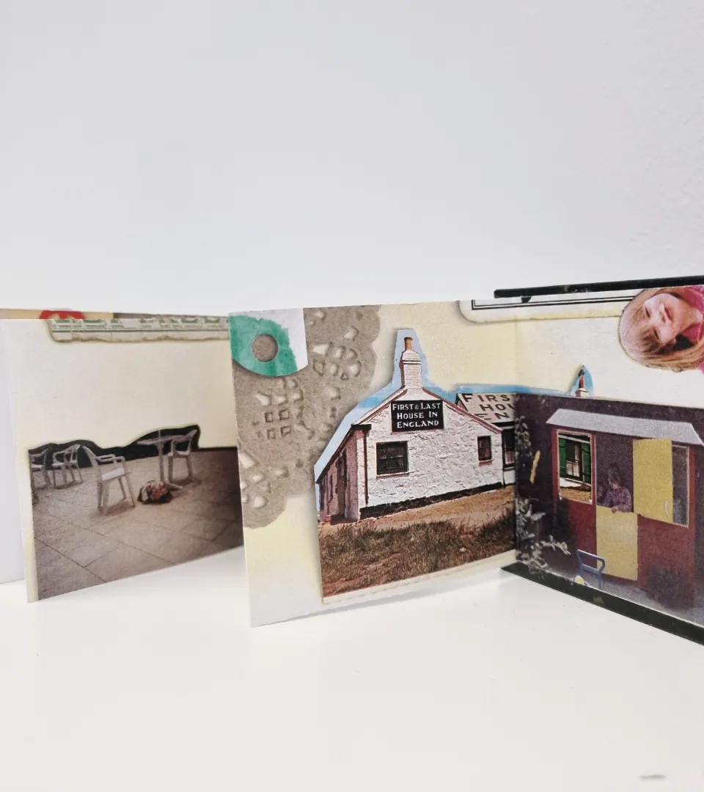
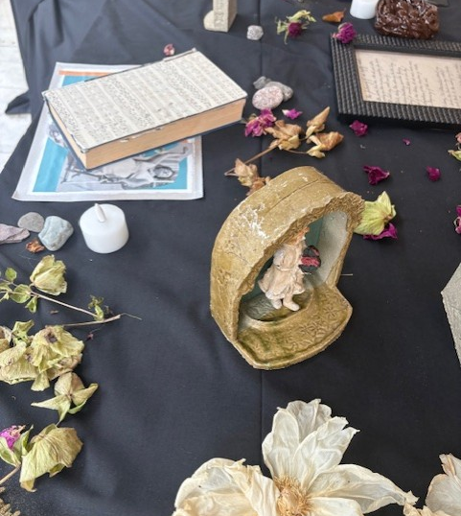

Slide 12
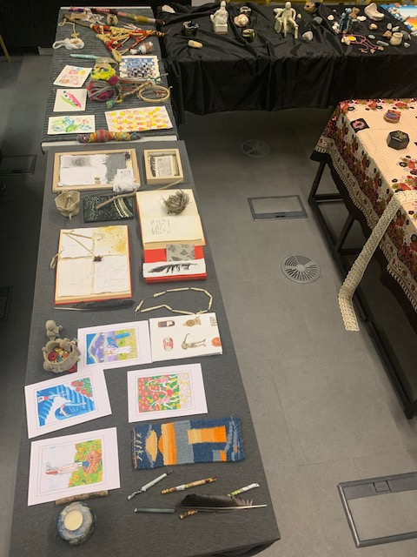
“Classroom layout and seating arrangements not only influence students' perception of the physical environment but could also play a crucial role in shaping their learning experience, academic performance, academic satisfaction and in their evaluation of a course and instructor’s teaching” (Makaremi et al., 2024).
Makaremi, N., Yildirim, S., Morgan, G., Touchie, M., Jakubiec, A. and Robinson, J. (2024) Impact of classroom environment on student wellbeing in higher education: Review and further directions. Building and Environment, 265.

Slide 13
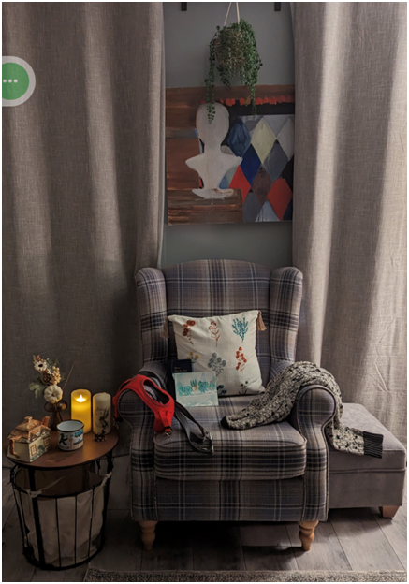
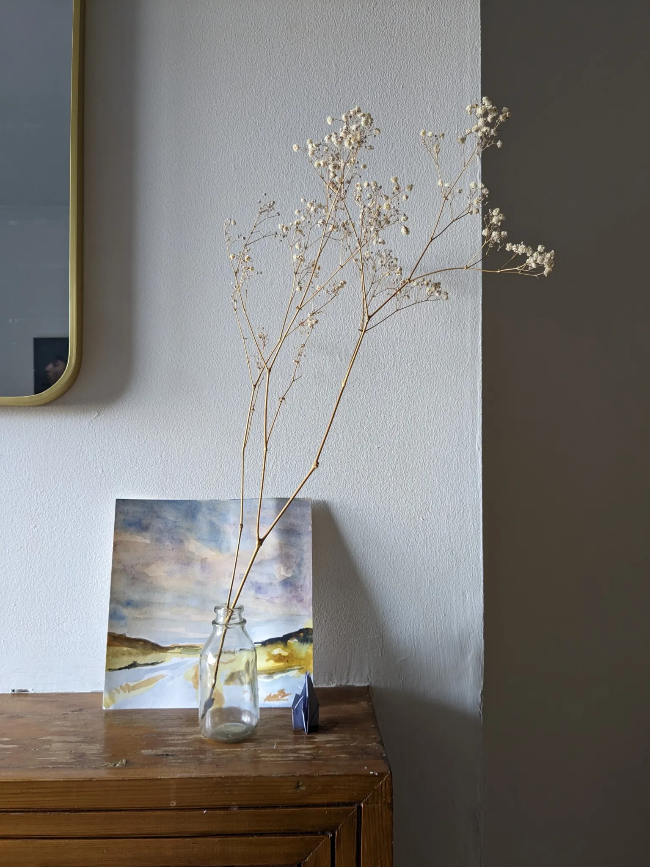
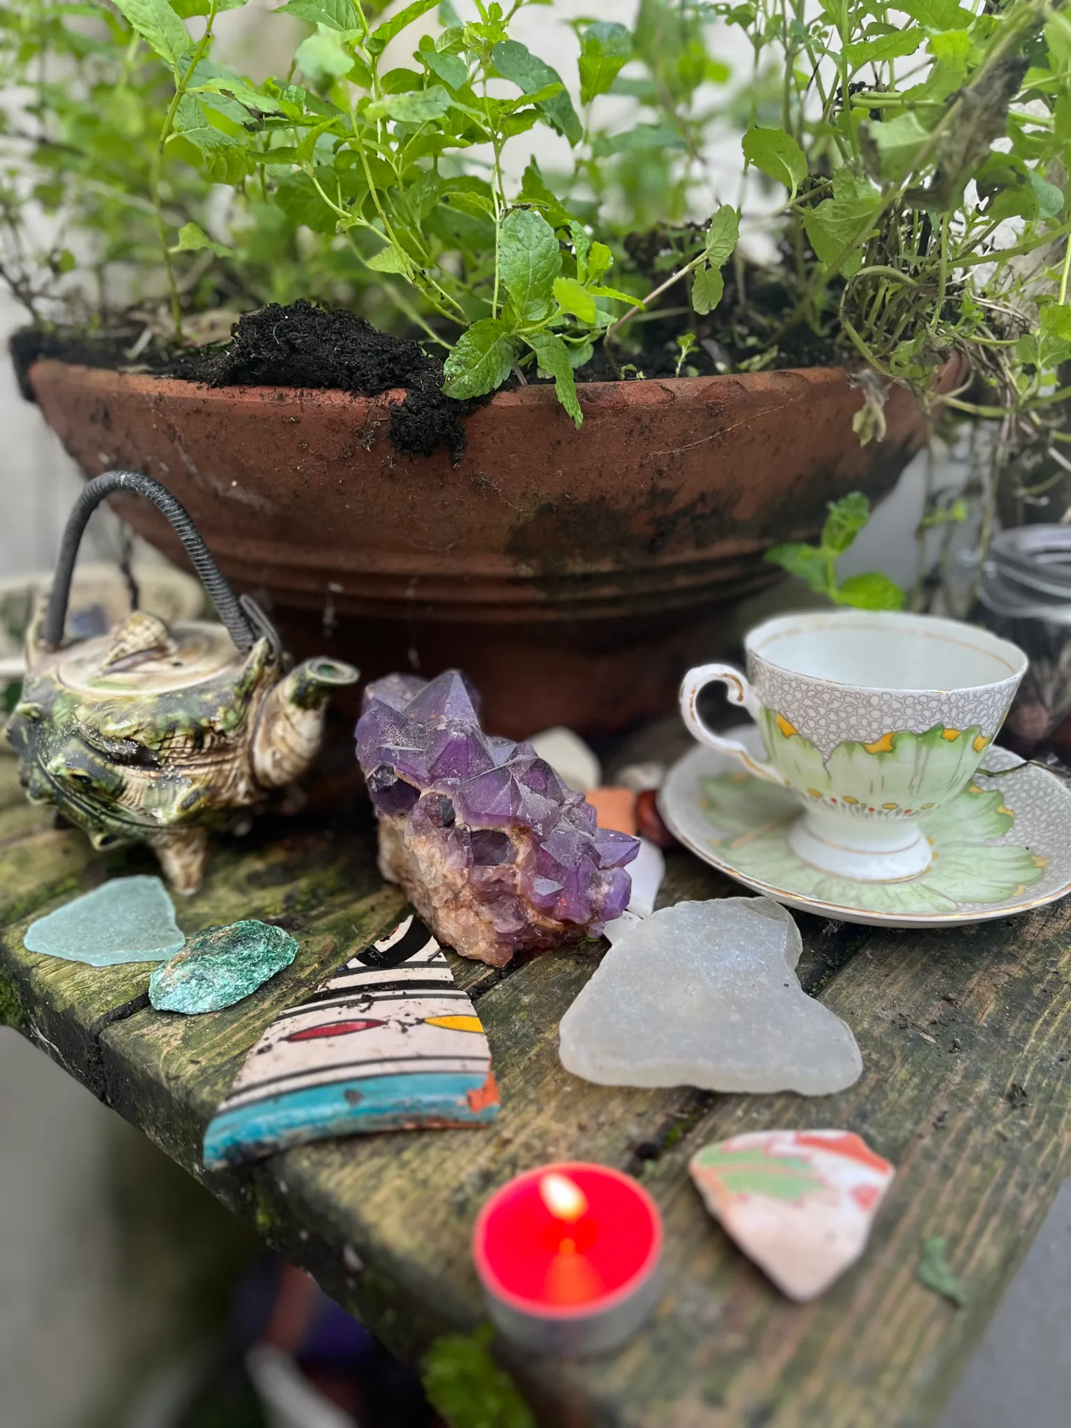
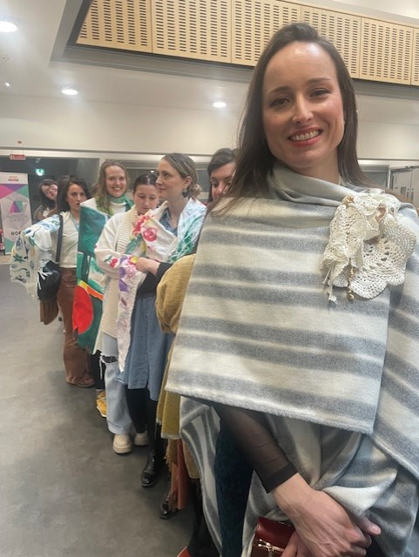

Slide 14
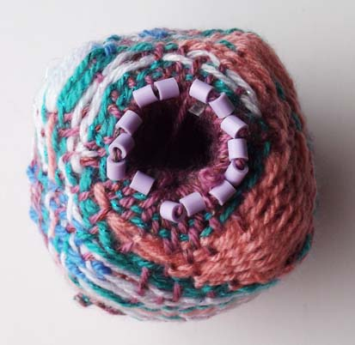
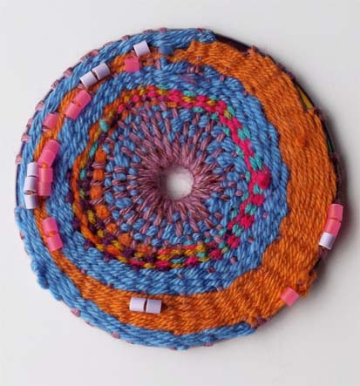
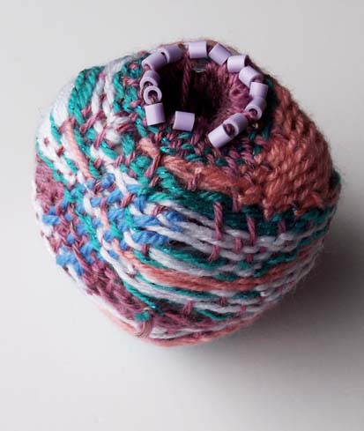
“Each session grounded and brought my body to engage with my senses. Smell has been a huge factor with the use of natural materials and evoked childhood memories.”
“Loved the togetherness of today’s project and the intentions. Very calming and grounding, and it felt nostalgic to me.”
“So simple, beautiful and engaging. I really enjoyed this.”

Slide 15
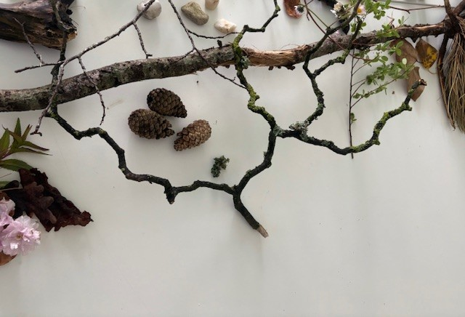
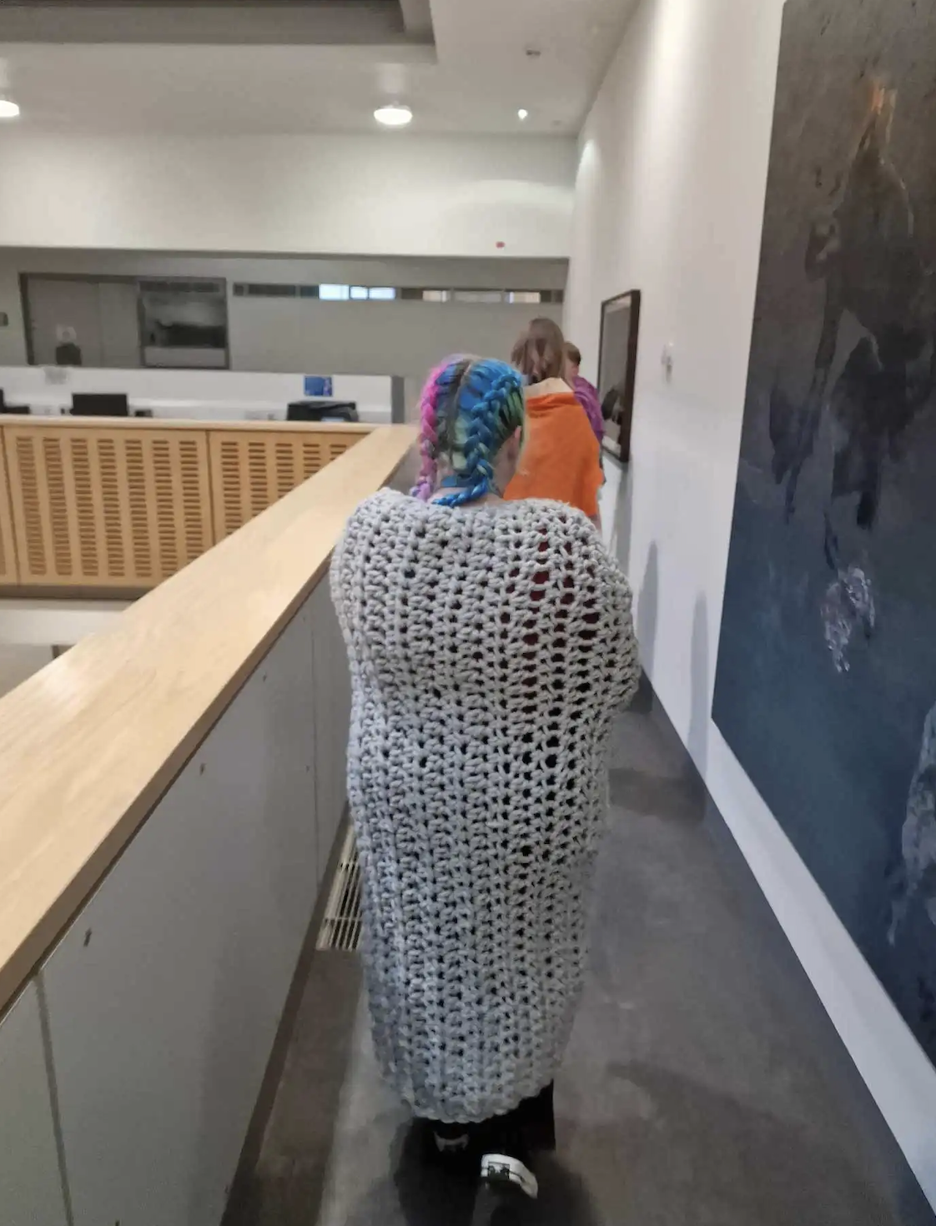
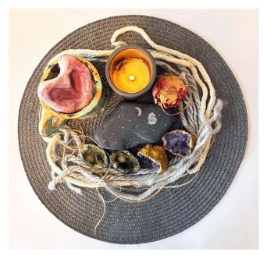

Slide 16
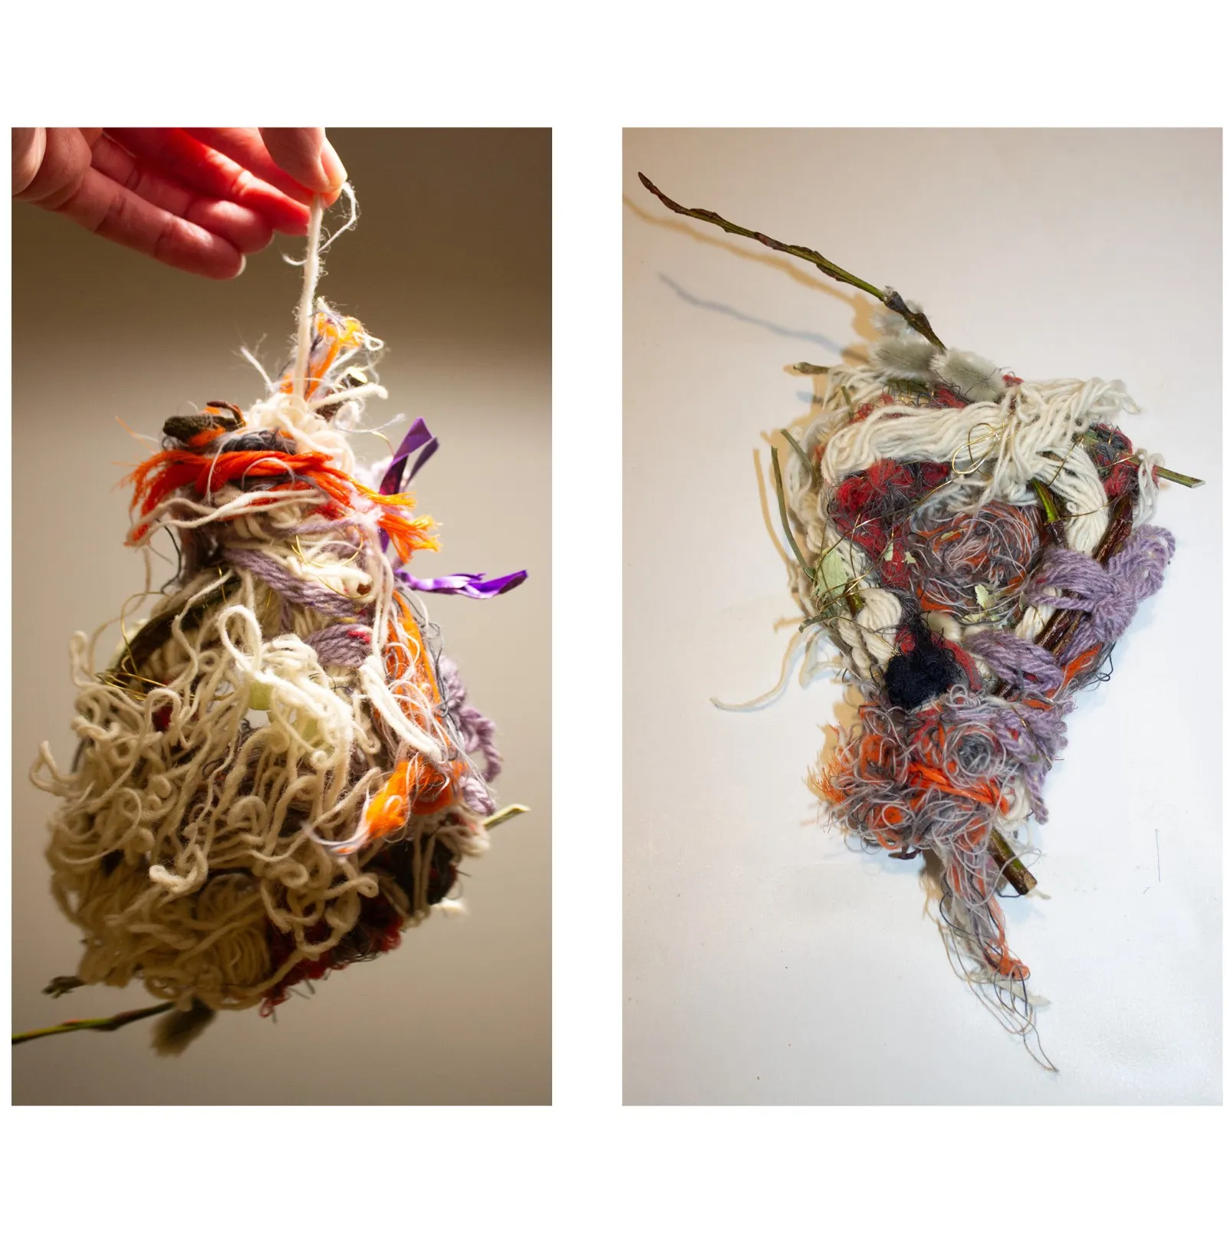
Learning from Others
Interaction
Going back to our roots
Gathering
Natural Feelings
Connection
A reason to come to class
Relational
Less intimidating
MSc Art Psychotherapy learner responses to the ecology of care model

Slide 17
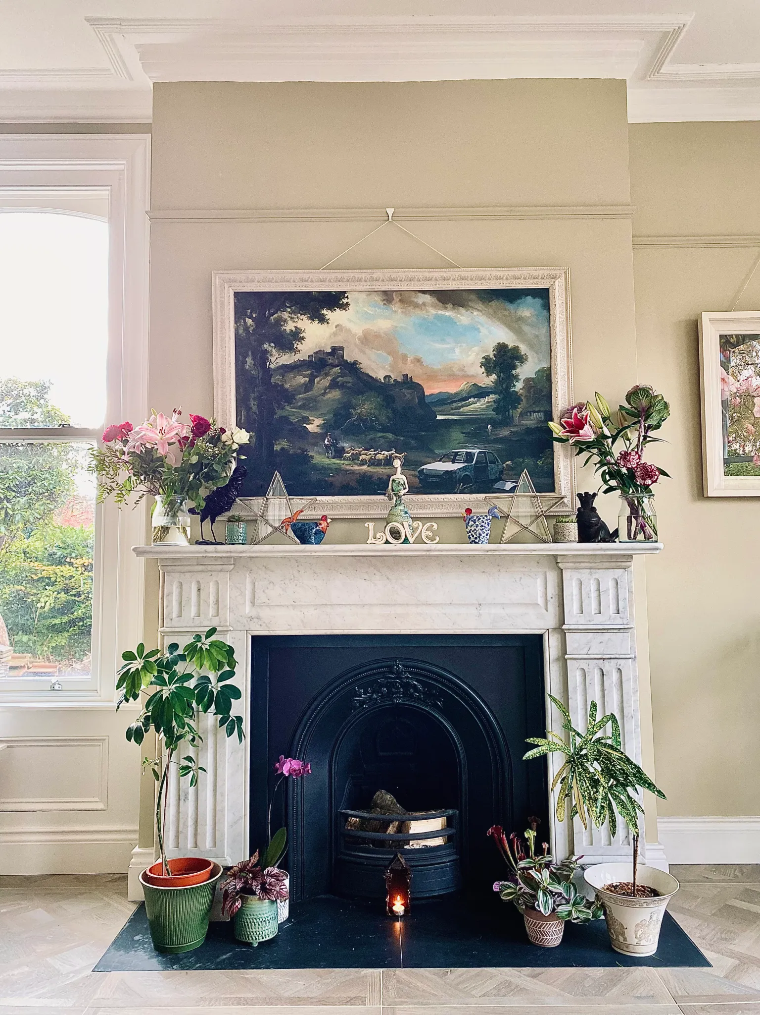
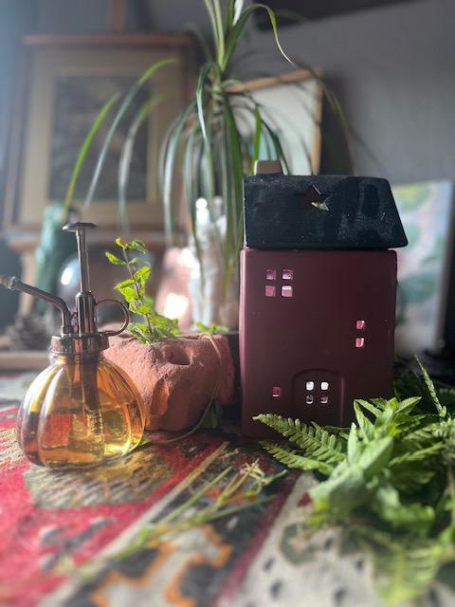
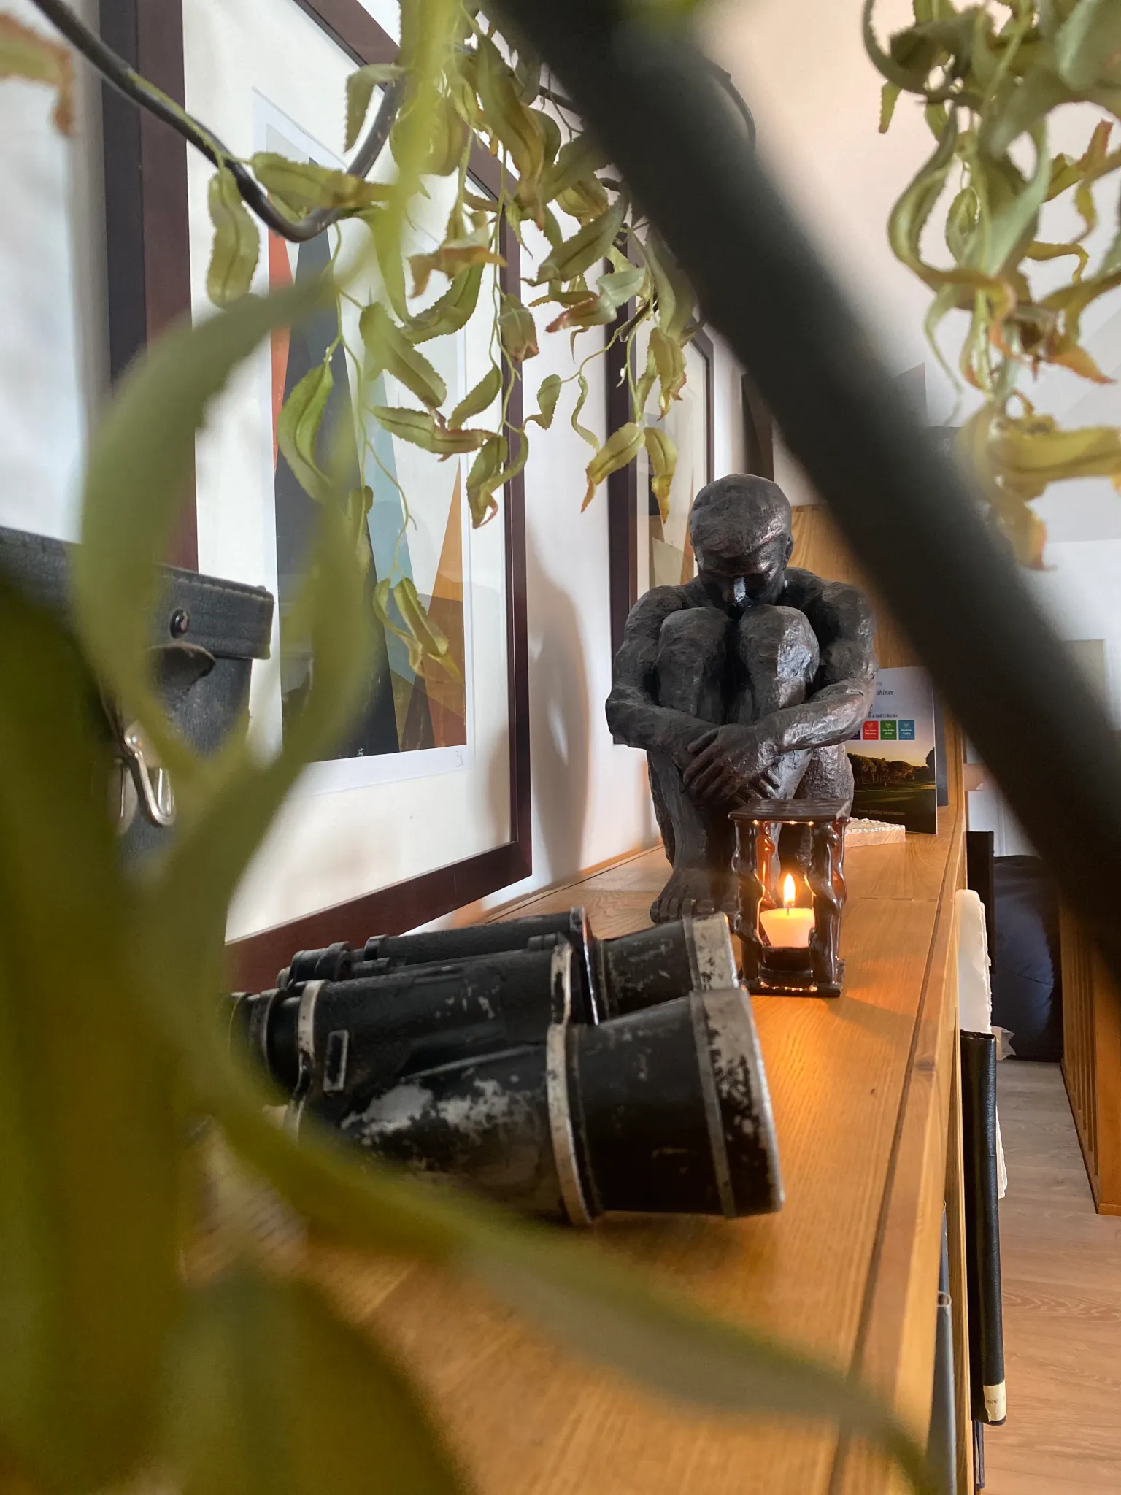

Slide 18
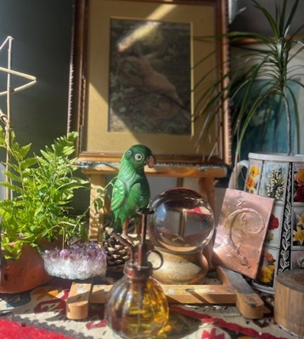
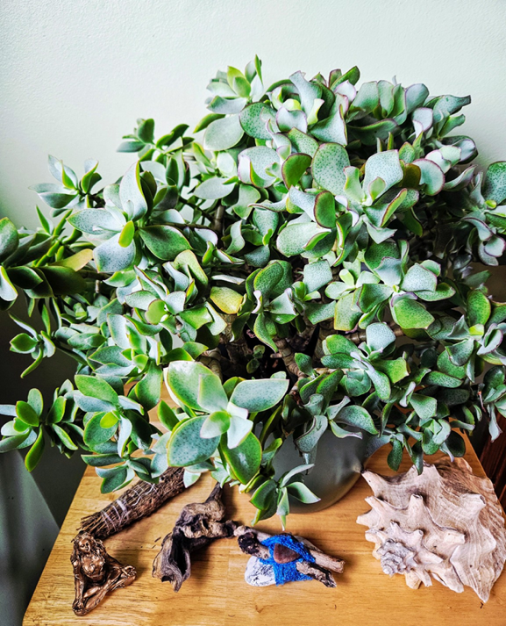
More connections with lecturers
A focus on objects is a chance to be non-verbal
Softening
Puts us at ease
It’s a space to gather
It helps me to orient myself
Improves group rapport
A chance to get to know people
It develops community
MSc Art Psychotherapy learner responses to the ecology of care model

Slide 19
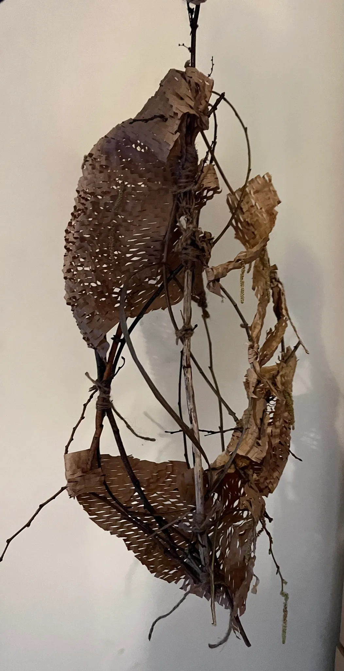
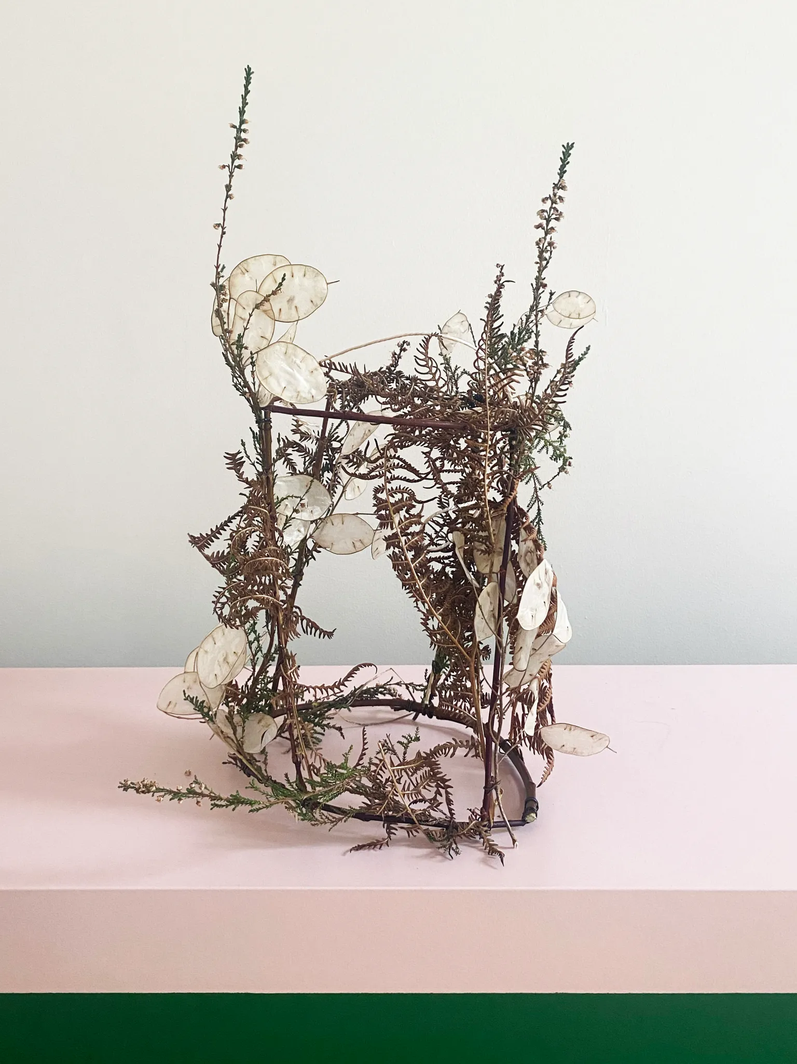
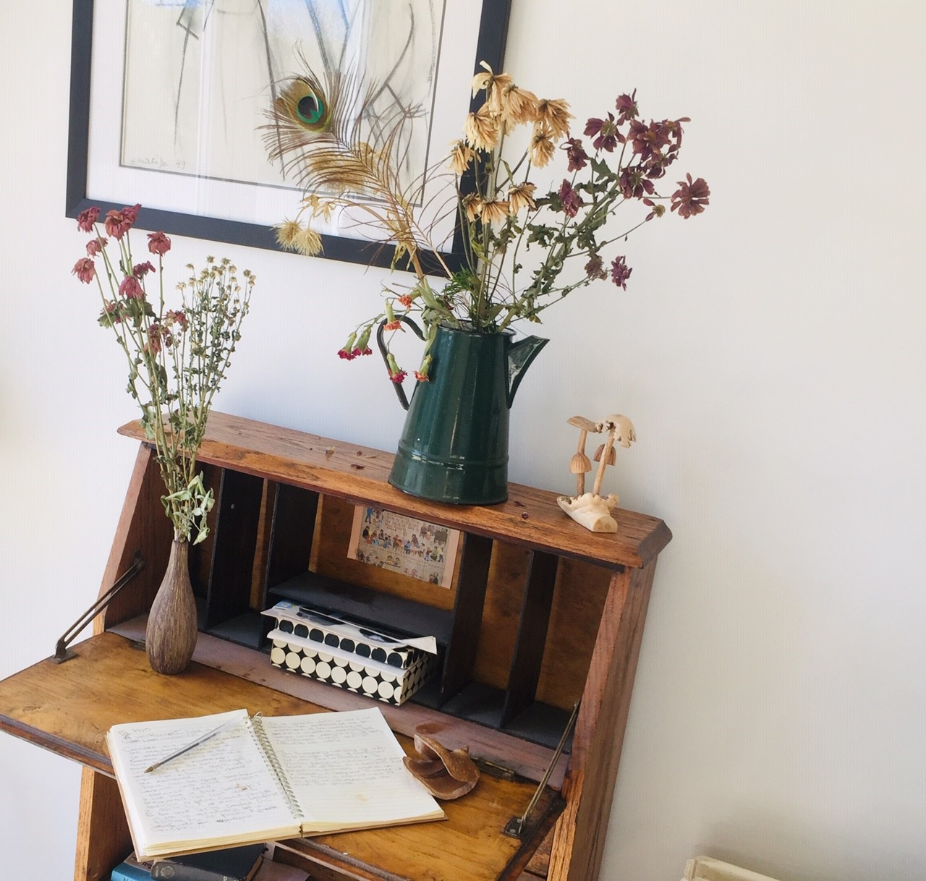
Support structures, vessels, containers and the nature of self care.

Slide 20
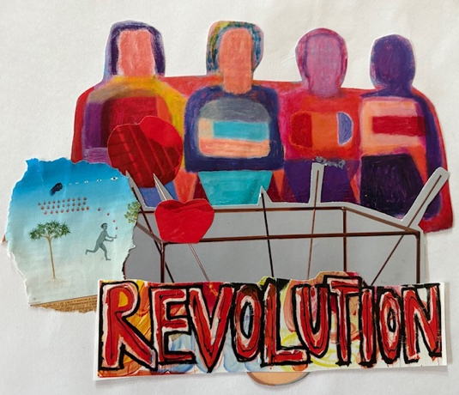
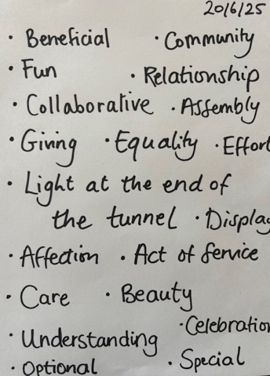
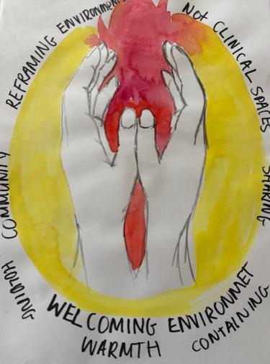
Breaks Down Barriers
Promotes inclusion and curiosity
A conversation starter
Nostalgia
Reframing environments
Warm and containing
Holding
Celebrating the beautiful
Fun
Equality
MSc Art Psychotherapy learner responses to the ecology of care model

Slide 21
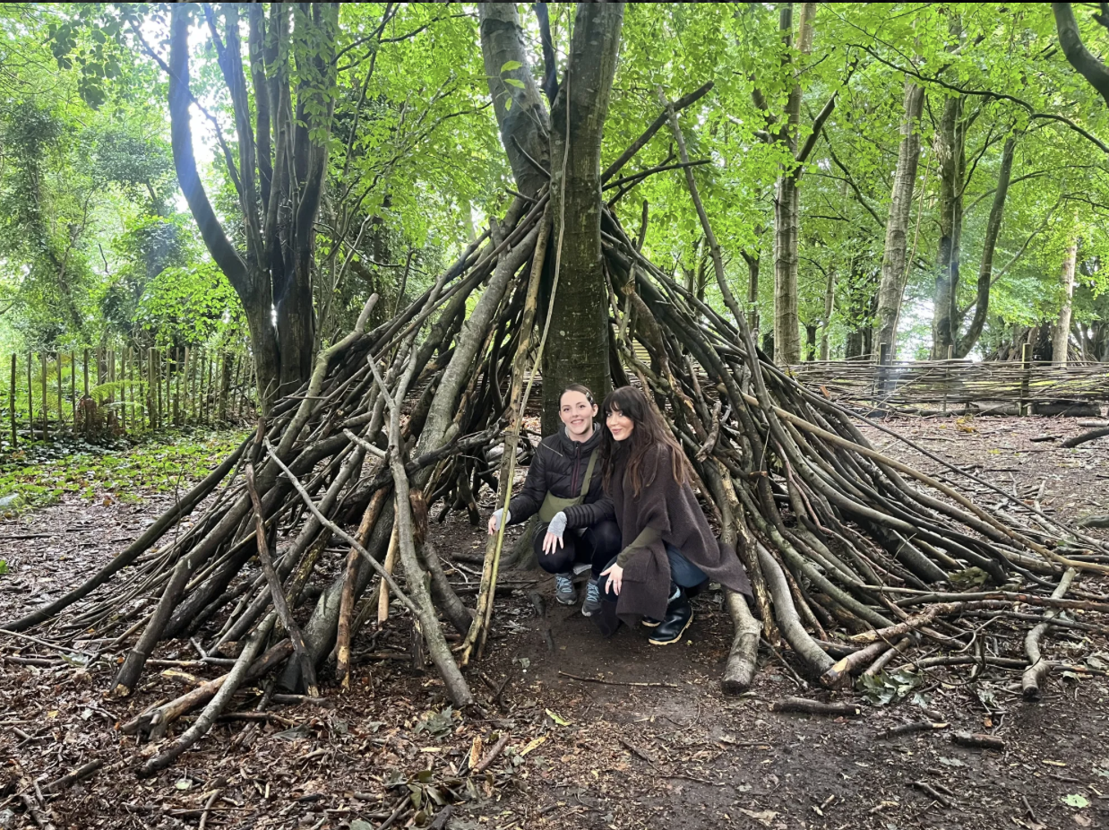
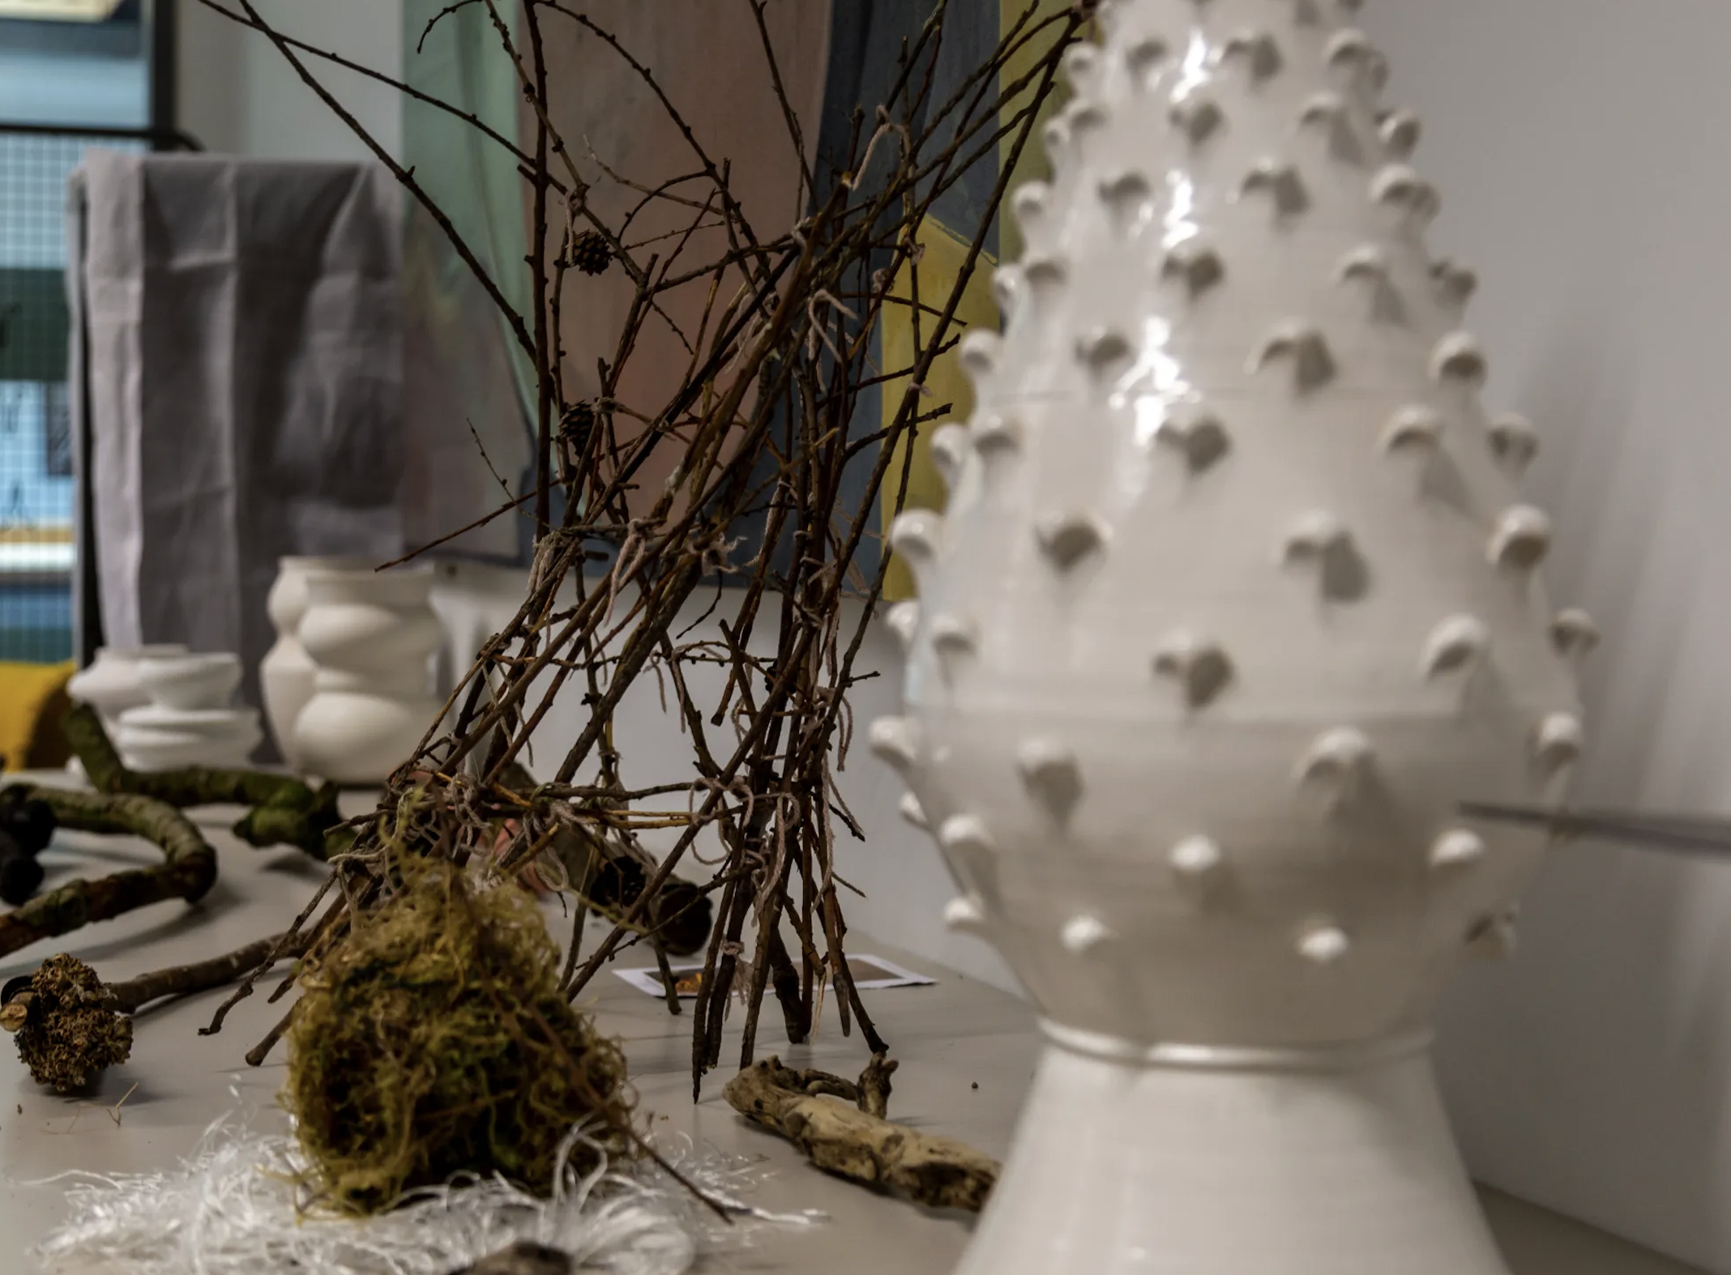

Slide 22
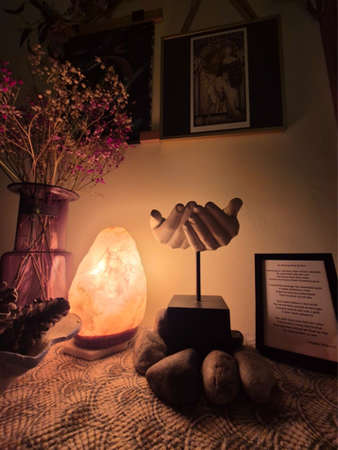
“This home décor arrangement reminds me that care can be both felt and arranged, intuitively composed, yet deeply significant.
It reflects a personal ecology of care, a quiet system of interconnected elements that nourish, support, and transmit care to me.
More than decoration, this is an invitation to attune, to slow down, notice, and connect with nature, memory, and self.
The placement of materials, the presence of organic forms, and the quiet symbolism of everyday objects foster safety, containment, and relational depth.
These are not aesthetic choices alone, they are intentional acts of care. Bringing this ecology into my work honours the body and the environment as co-regulators, each holding space for what may not yet be spoken” (MSc Art Psychotherapy, research participant, personal communication, July 22 2025).

Slide 23
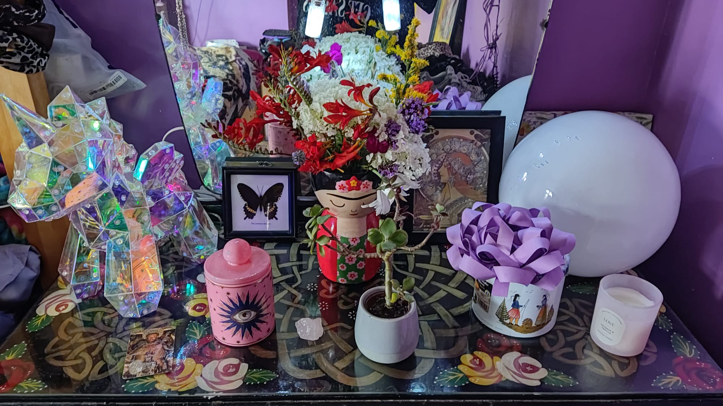
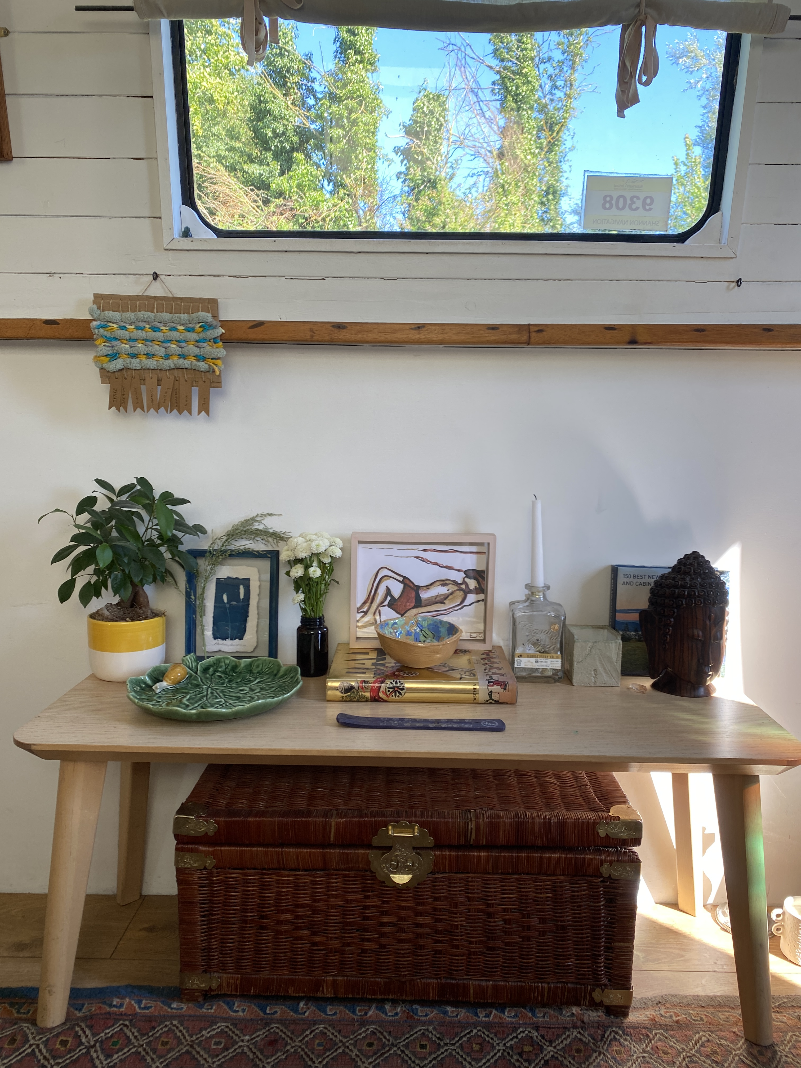
Ecologies of care displays by MSc Art Psychotherapy students.

Slide 24
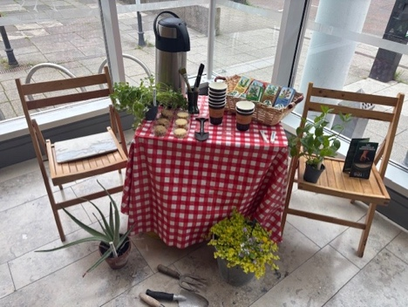
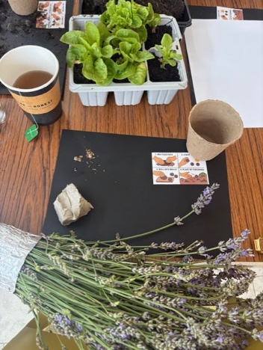
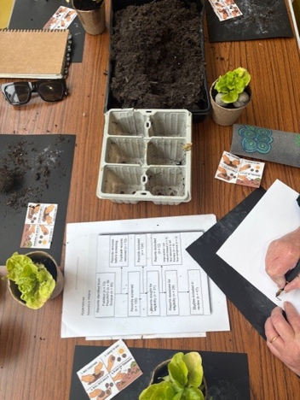

“I have created displays all around my house. I now feel pride about everything I own. I have organised my possessions into personal exhibitions. I have placed objects together which are either found, inherited or acquired as a reflection of myself” MSc Art Psychotherapy, research participant, personal communication, July 15 2025).
“It acts as a visual reminder to pause, breathe, and take a moment to reflect, especially during full days or when shifting between tasks. It offers a quiet invitation to slow down and reconnect with myself, even if just for a moment” (MSc Art Psychotherapy, research participant, personal communication, July 15, 2025).

Slide 25

“Pedagogies of compassion…create a learning environment that notices distress and disadvantage…and takes steps to reduce these barriers to learning” (Killingback, Tomlinson and Stern, 2024).
Compassionate pedagogy promotes self-care, a trauma informed curriculum, psychological safety, relational engagement and collaborative knowledge making.
Mental health promotion should be a campus wide ethos representing a duty of care to learners, educators and professional staff.
Killingback, C., Tomlinson, A., and Stern, J. (2024) Compassionate pedagogy in higher education: A scoping review. Journal of University Teaching and Learning Practice, 21 (10).

Slide 26


Art and Design
Foundation Year
Students participating
in an Ecology of Care talk at
the Belfast School of Art,
Art Shop supported by the Northern
Ireland Mental Health Festival (December, 2025)

Slide 27


Celeste Owens, The Art Shop Feast and Tara Russell, Crossing into Quietness (Rest, Breathe, Soften, Relax Now)

Slide 28


Educators may unintentionally diminish the potential of learning, by asserting authority and influence within the classroom environment in terms of structuring the learning environment towards didactic (the planning, control and regulation of teaching) versus experiential learning. Active learning in higher education offers an alternative.
Active learning is characterised by a dynamic and interactive classroom experience supporting mental fitness (O’Brien et al., 2020a), a term used in association to physical fitness and meeting the demands of higher education.
O’Brien, N., Lawlor, M., Chambers, F. and O’Brien, W. (2020a) Mental fitness in higher education: Intervention mapping programme design. Health Education, 120 (1), 21-39.

Slide 29


Jasmine Ruddell, Temporary Relief

Slide 30


Tender Aid by Enya Fitzsimons and An Archive of Self Discovery by Jamie Lee Jordan

Slide 31
Eimear Scott, Abundance
“I try to fill my frame up with the abundance of life so there is no shortage of dreams to be dreamt whether you gaze at it from the inside or the outside. It is as important to look within as it is to look out”

Slide 32
Acknowledgements
Siobhán
Siobhán
Siobhán
Siobhán
Siobhán
á
Victoria Price, Brian McGowan, Drew Neill, Mel Kennedy,
MSc Art Psychotherapy 2023, 2024 and 2025 Graduates,
Art and Design Foundation Year Students, Yasmine Robinson,
Adriana Ionascu, Siobhán Bereen and Gerard Lee
Contributor name Pamela Whitaker
Job Title Lecturer Art Psychotherapy
School/Dept Belfast School of Art
Email address p.whitaker@ulster.ac.uk

Slide 33
End Slide (Core blue background with Ulster University crest and ulster.ac.uk web address in white)

